Slide 1


Polish Christian Ministries exists to assist Polish Christians in becoming healthy, growing, self-supporting and reproducing congregations.

Slide 2

Current Population of Poland
38,443,964

Slide 3
Our Focus in Poland
Providing Resources
Personal Relationships
Planting Churches

Slide 4
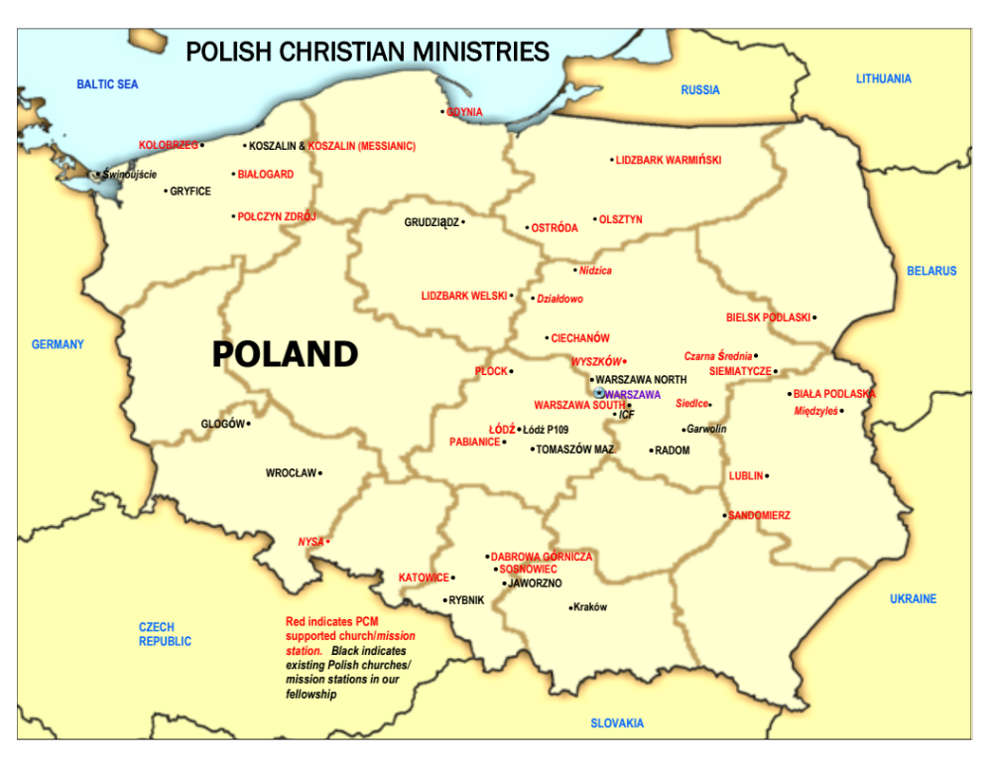
*29 churches
*2 new church plants in 2015

Slide 5
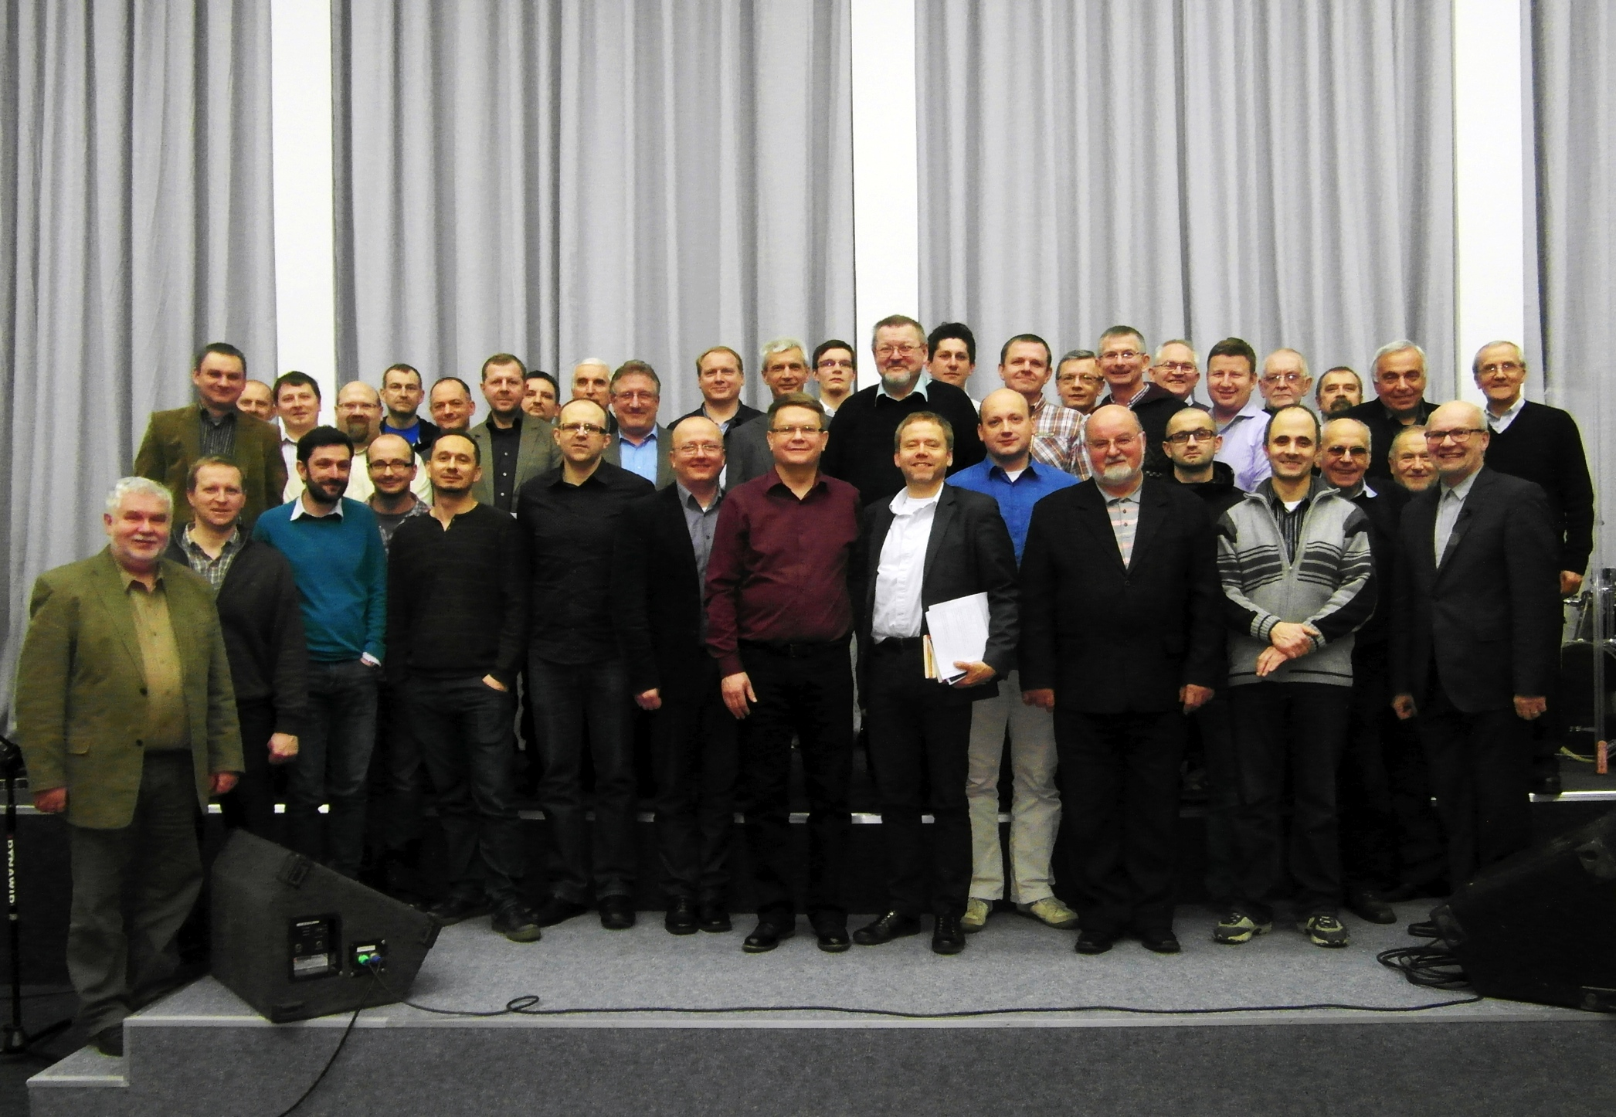
Pray for the 40+ pastors and their churches to be the light of the Gospel and preach the truth in their city. May the name of Jesus become famous in the nation of Poland.

Slide 6
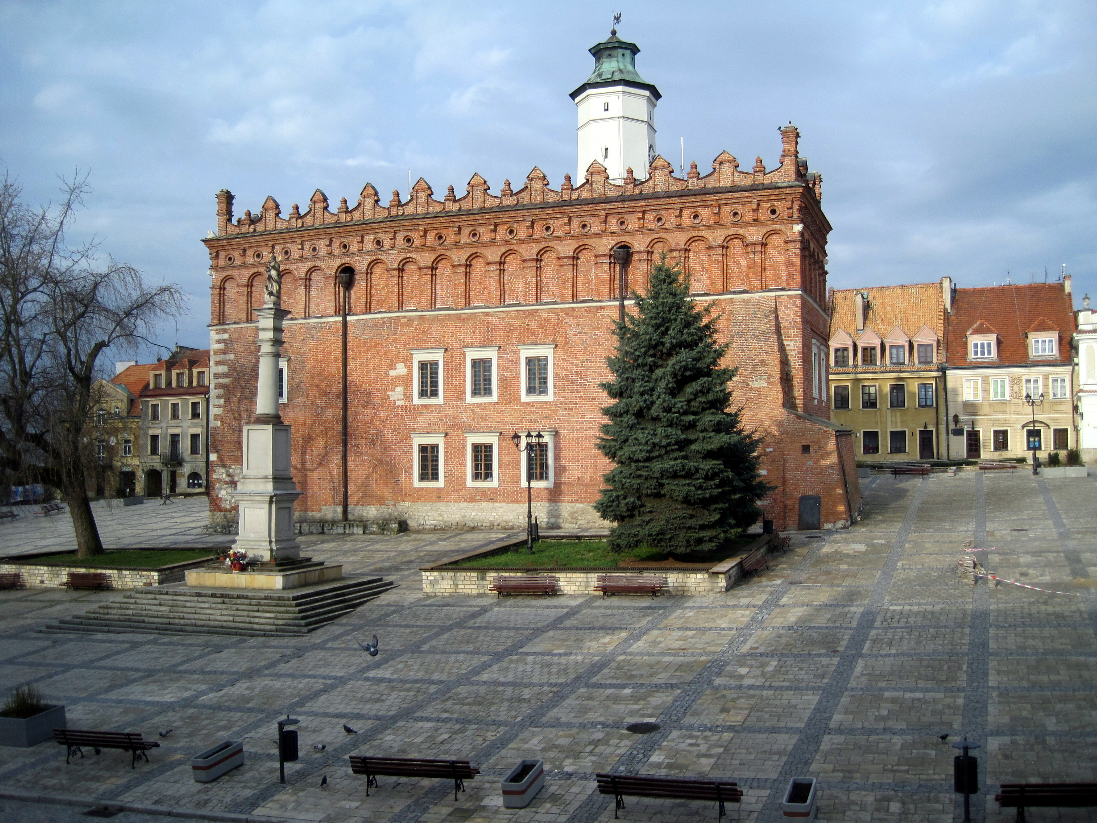
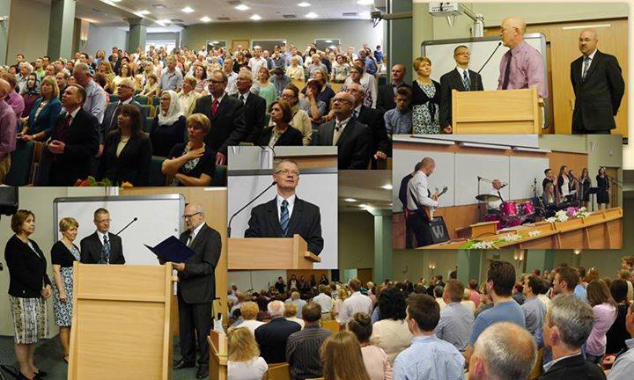
This past year the church in Olsztyn celebrated its 70th year of ministry. They were established in 1945 just after World War II ended in Europe.

Slide 7
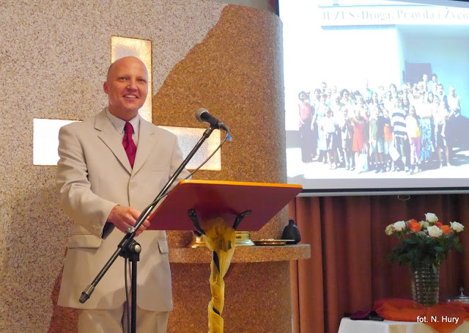
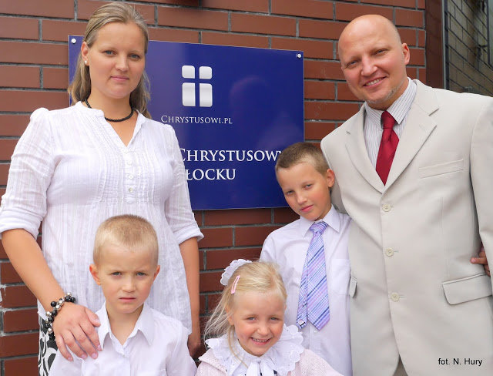
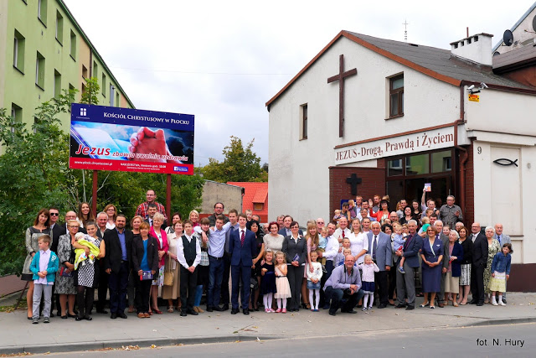
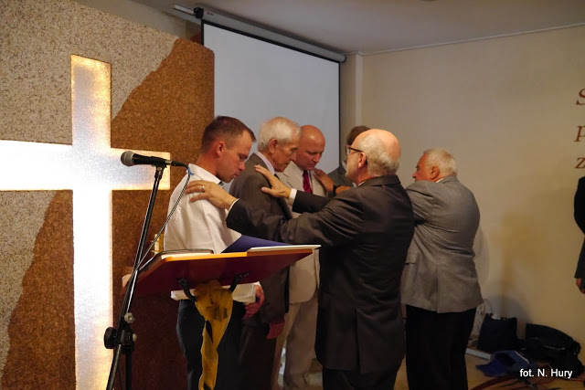
Plock celebrated 25 years of serving in their city
The church in Płock received a new pastor in 2015 and celebrated its 25th year of ministry. They were established just after the fall of Communism in 1990.

Slide 8
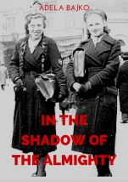

In 2015, John Stott’s book, The Radical Disciple, was translated into the Polish language. In the Shadow of the Almighty, written by Adela Bajko, was translated into English.

Slide 9
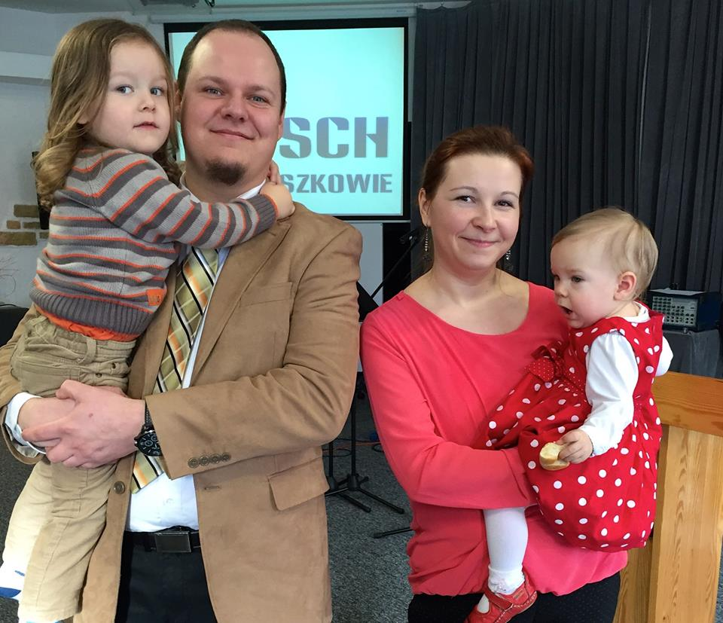
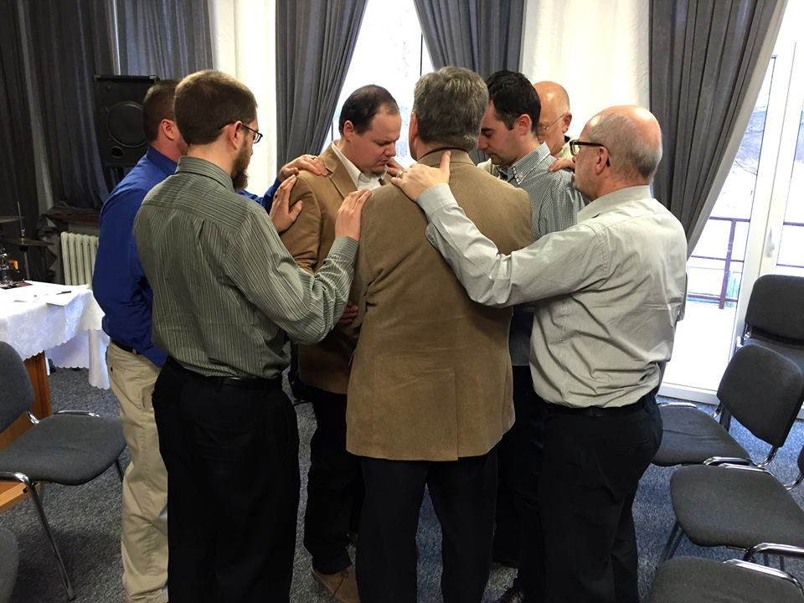
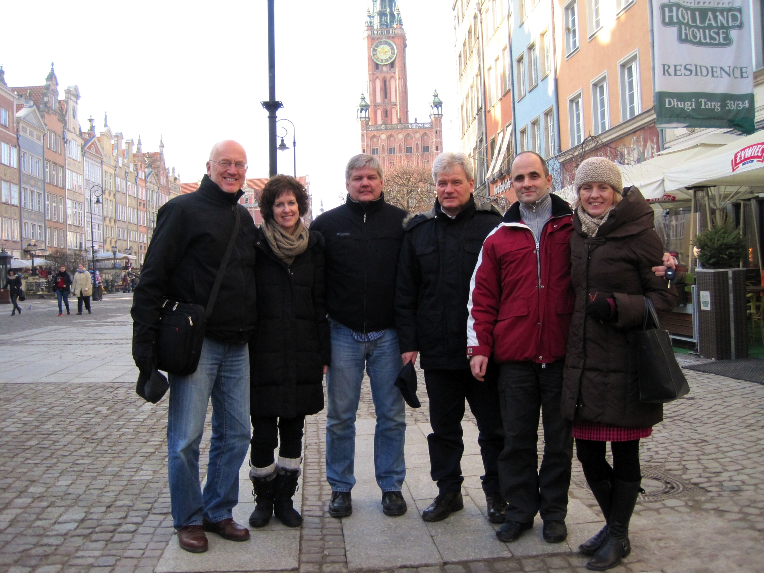
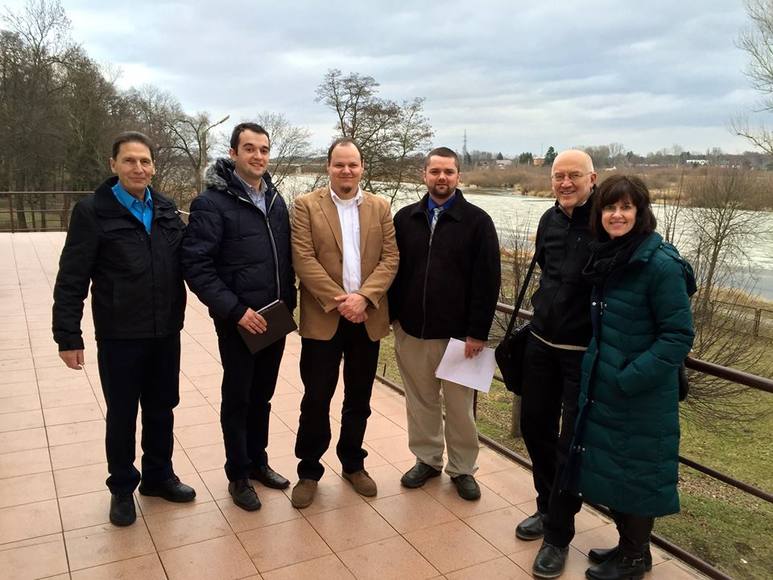
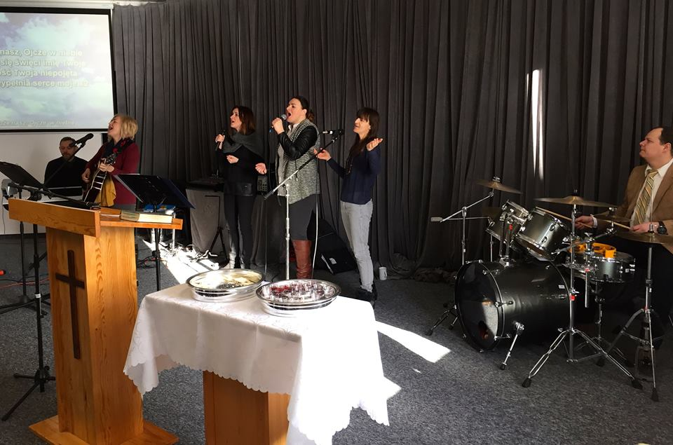
Łukasz Osik is the Lead Pastor in Wyszków, the newest church plant in Poland. Wyszków is a city of 15,000. The church is averaging 40+ on Sundays.

Slide 10
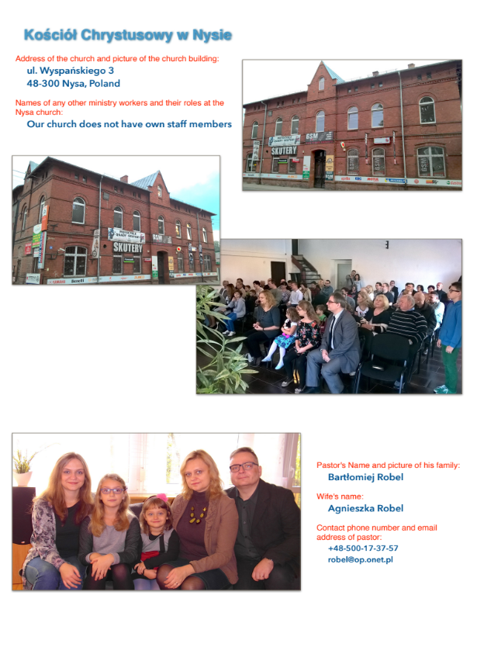
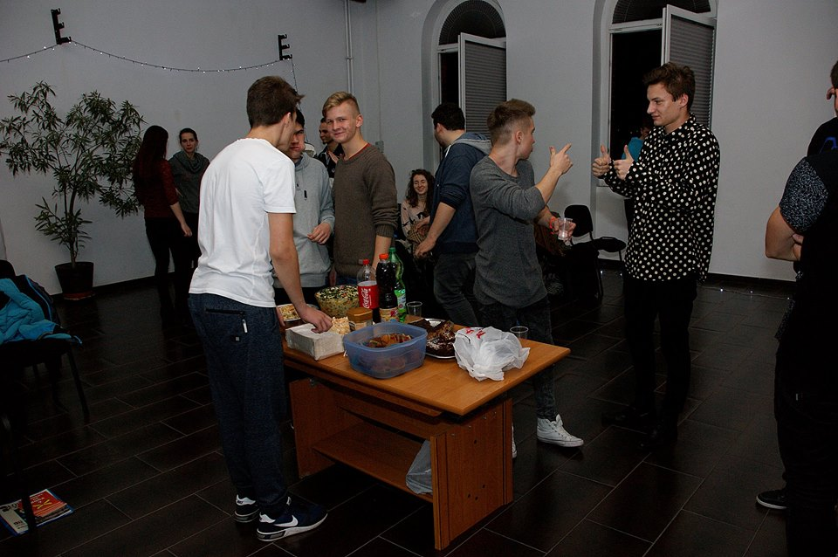
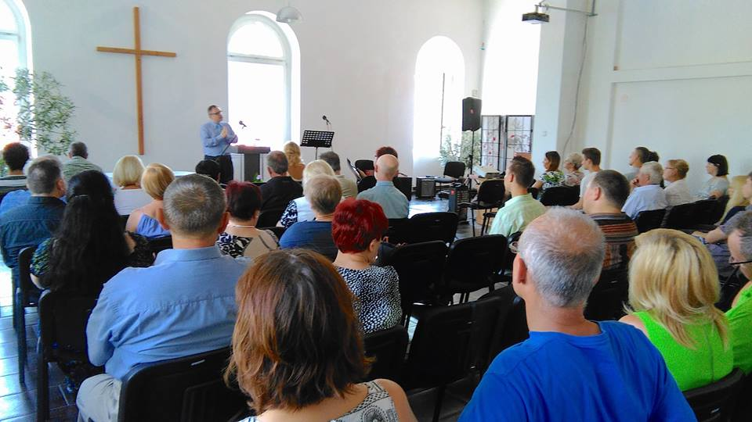
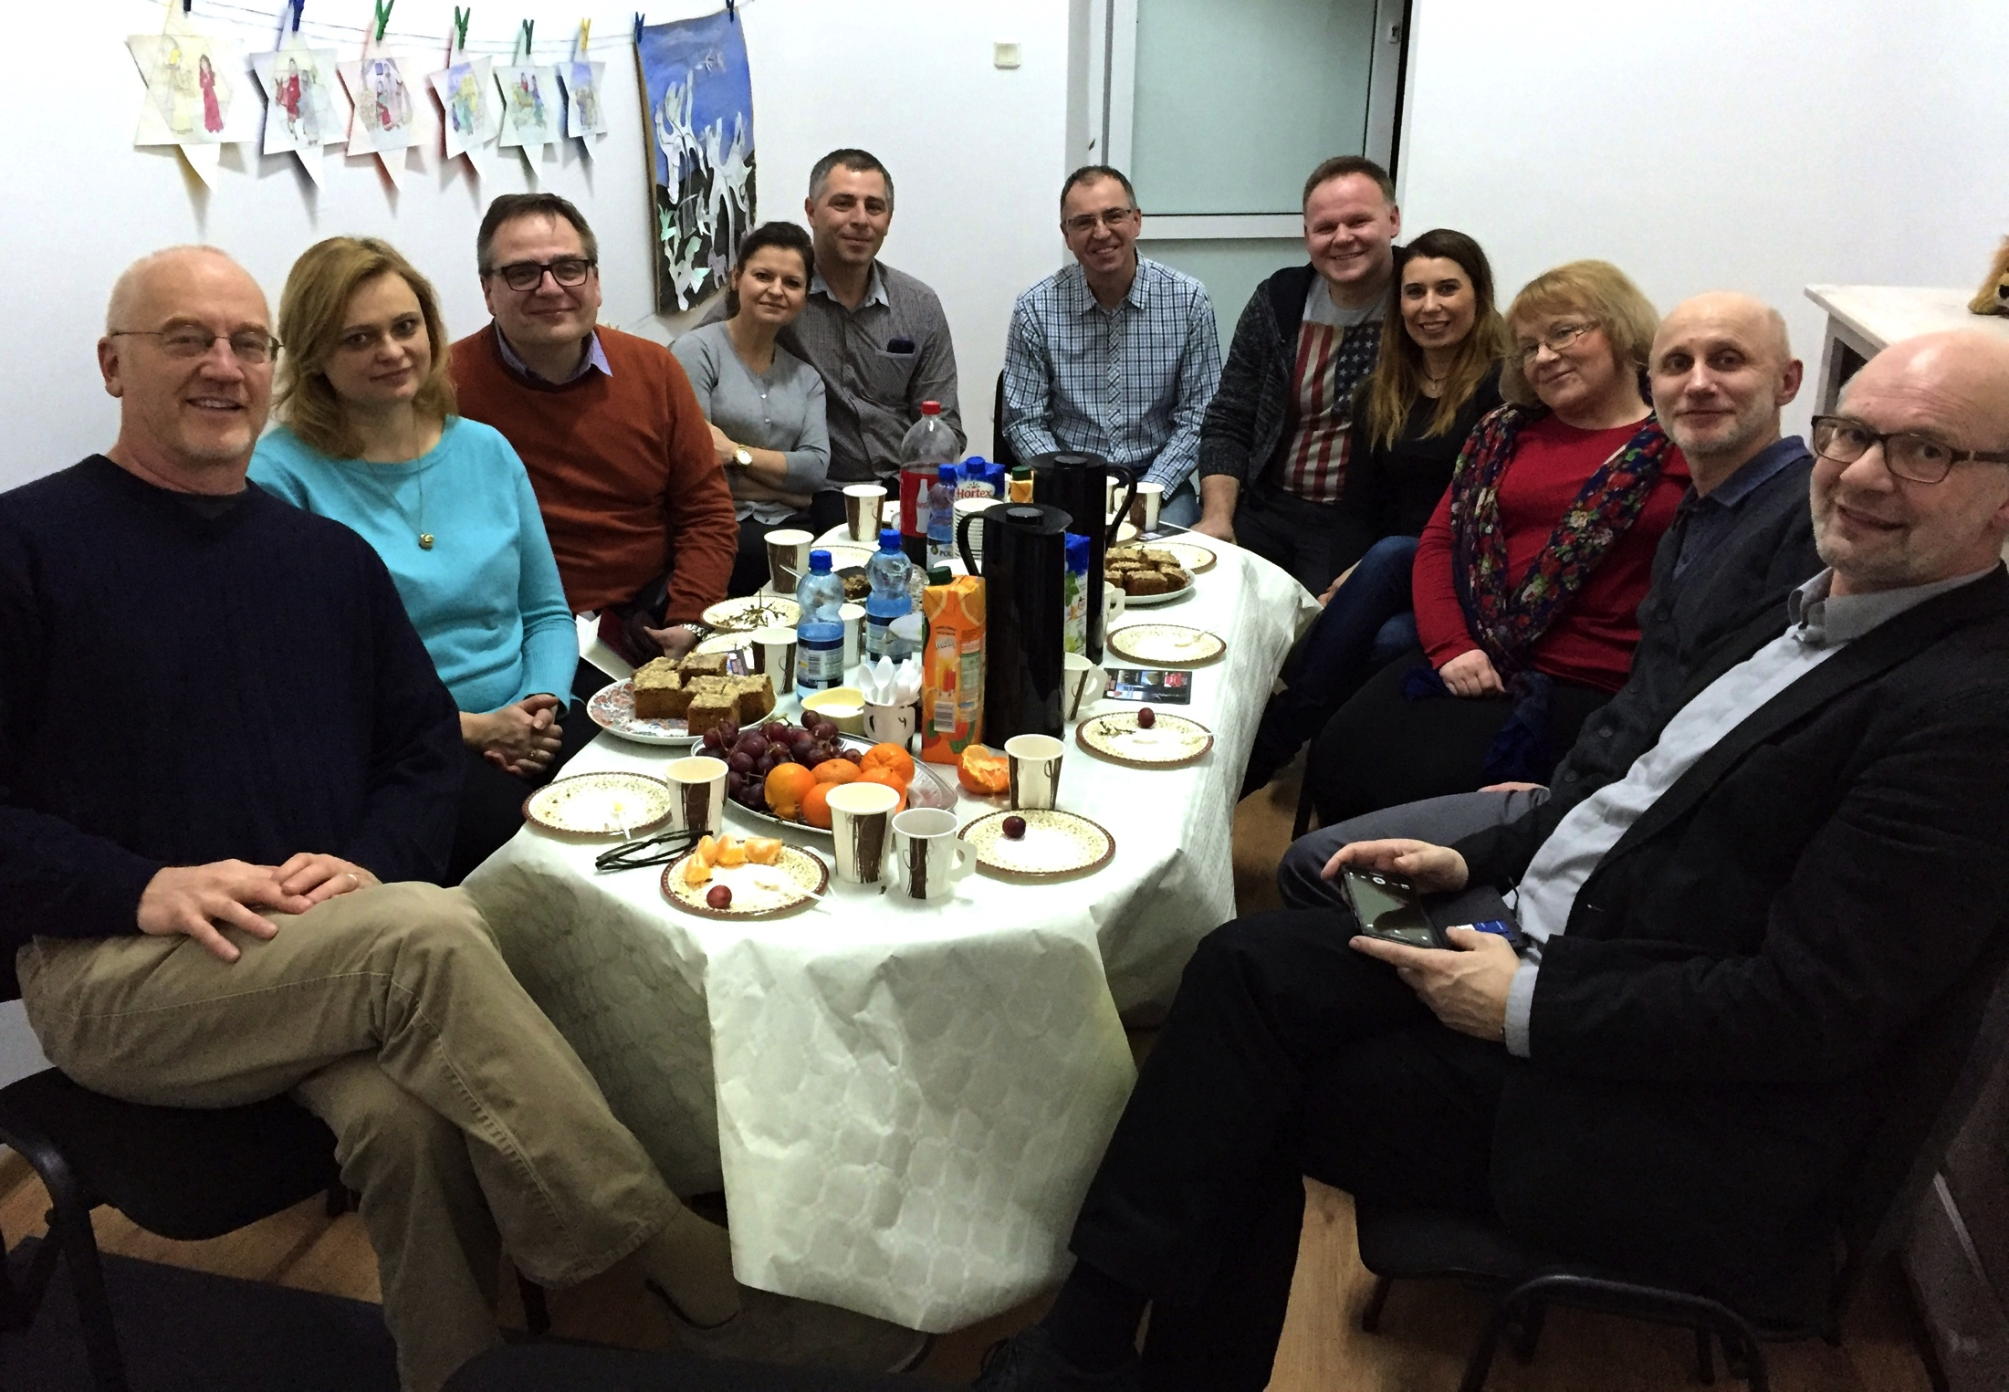
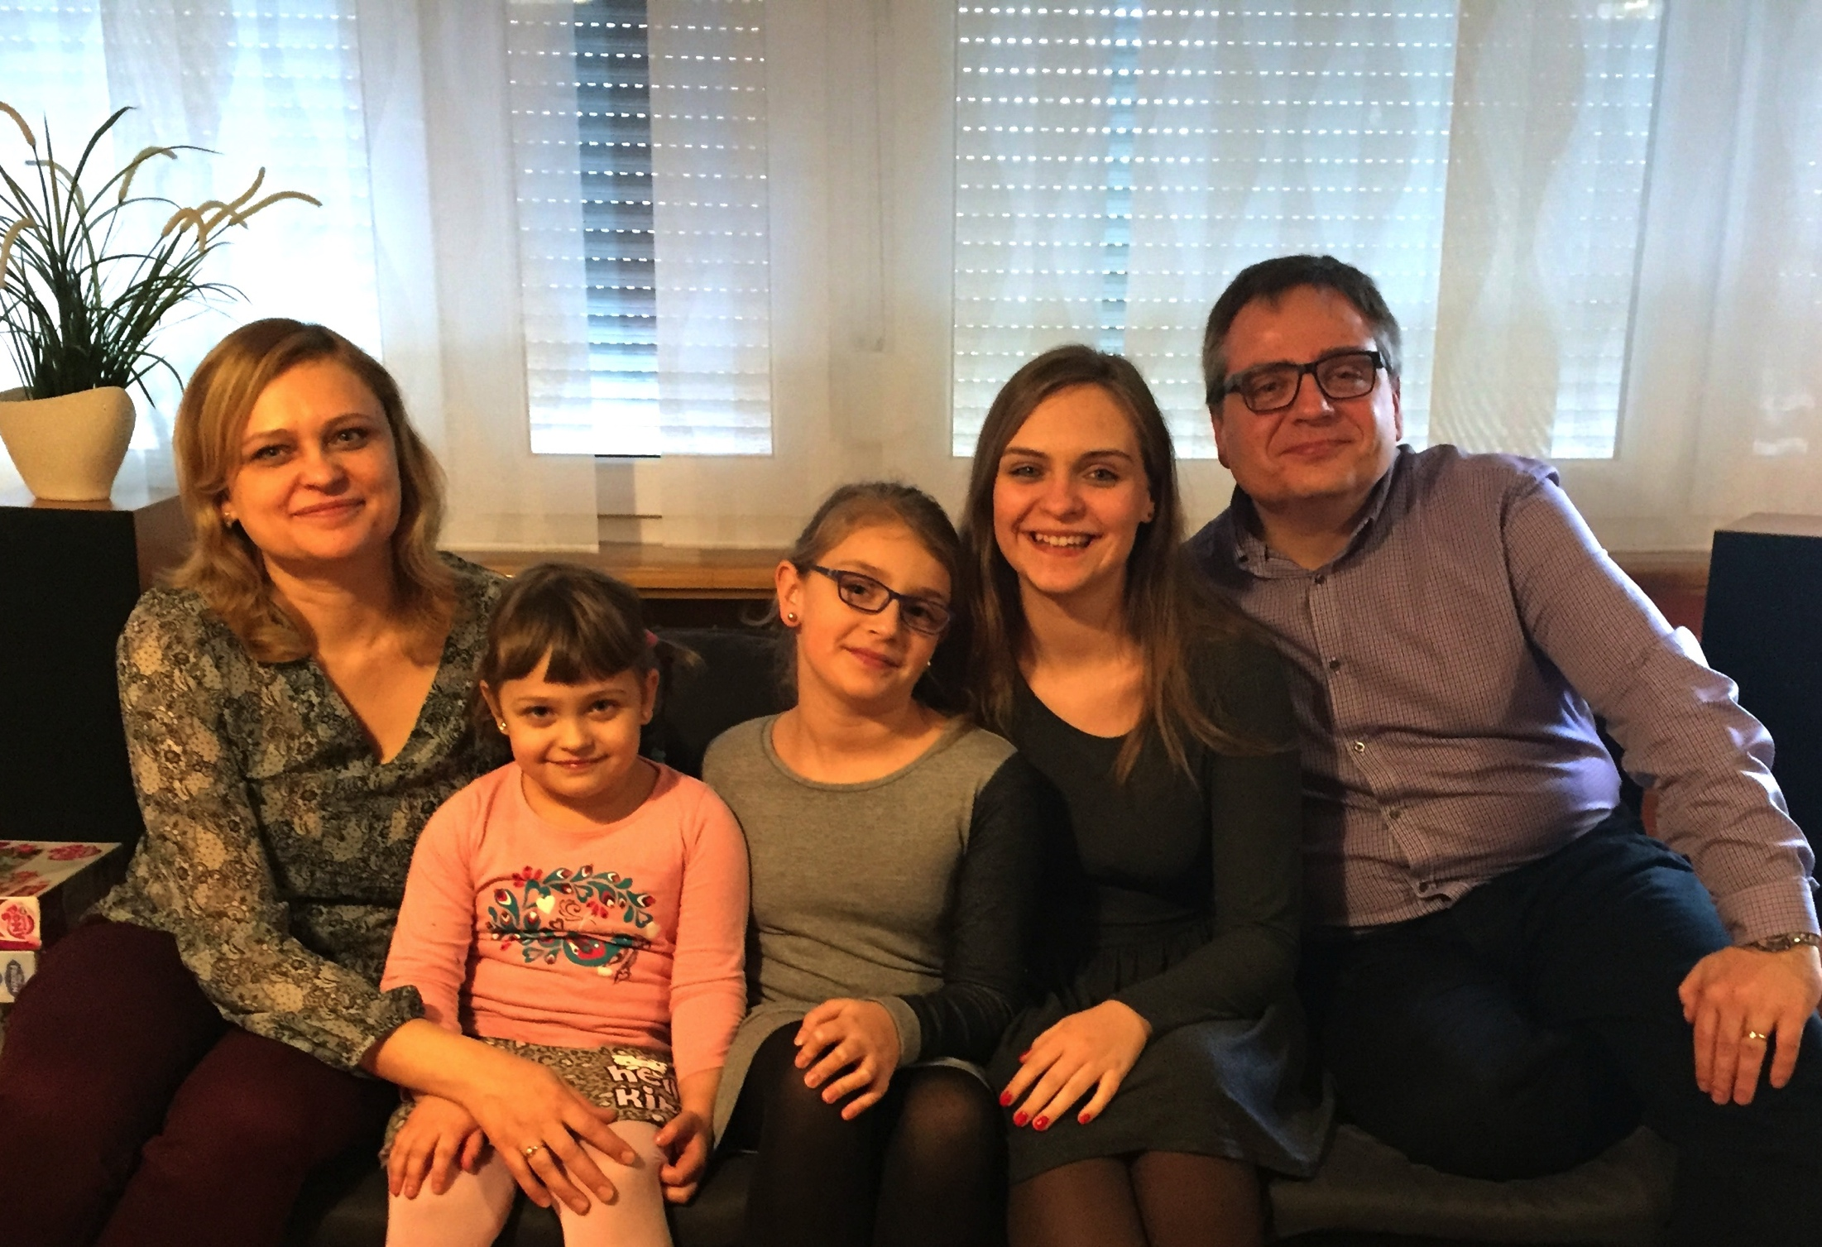
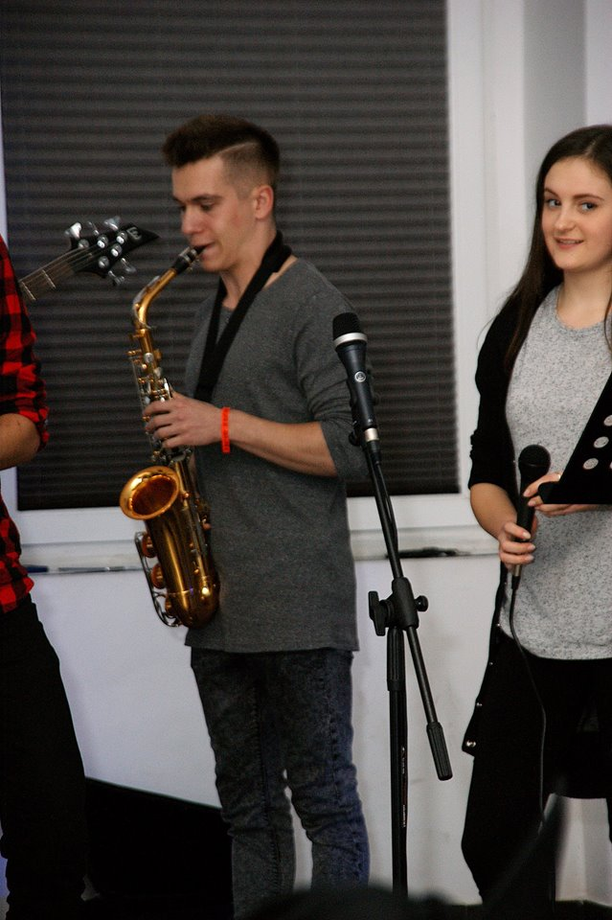
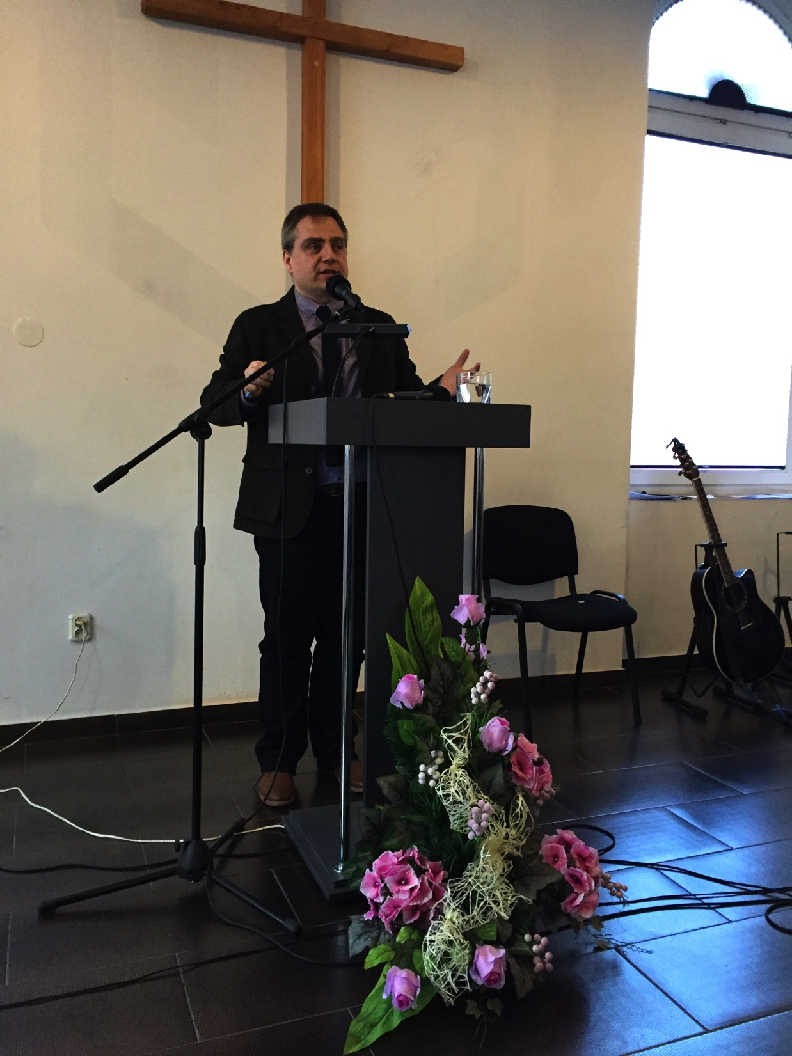
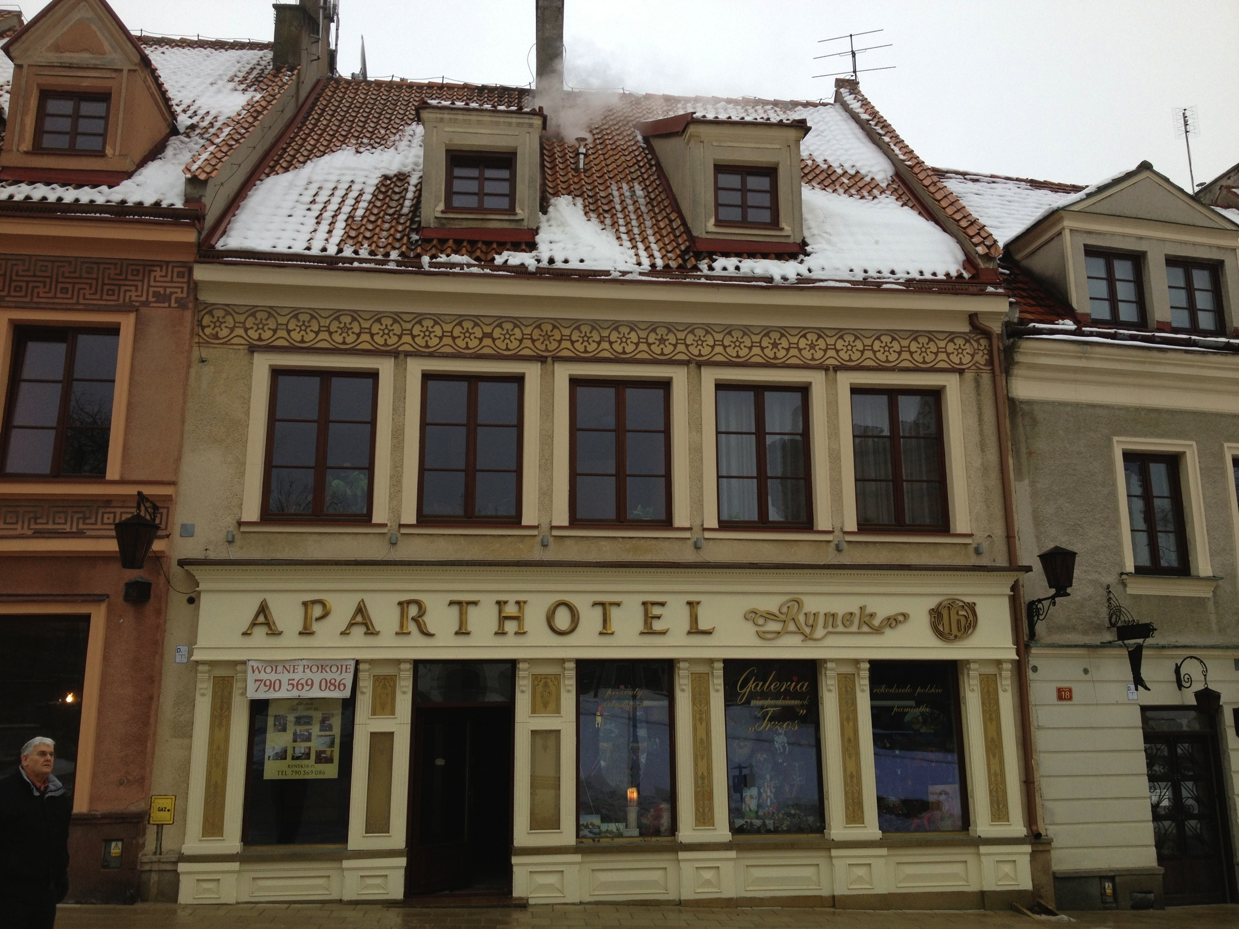

N
Y
S
A
Bartłomiej Robel is the Lead Pastor in Nysa. The church registered with the Fellowship of Christian Churches in 2015. Nysa is a city of 48,000. They average 50+ on Sundays.

Slide 11
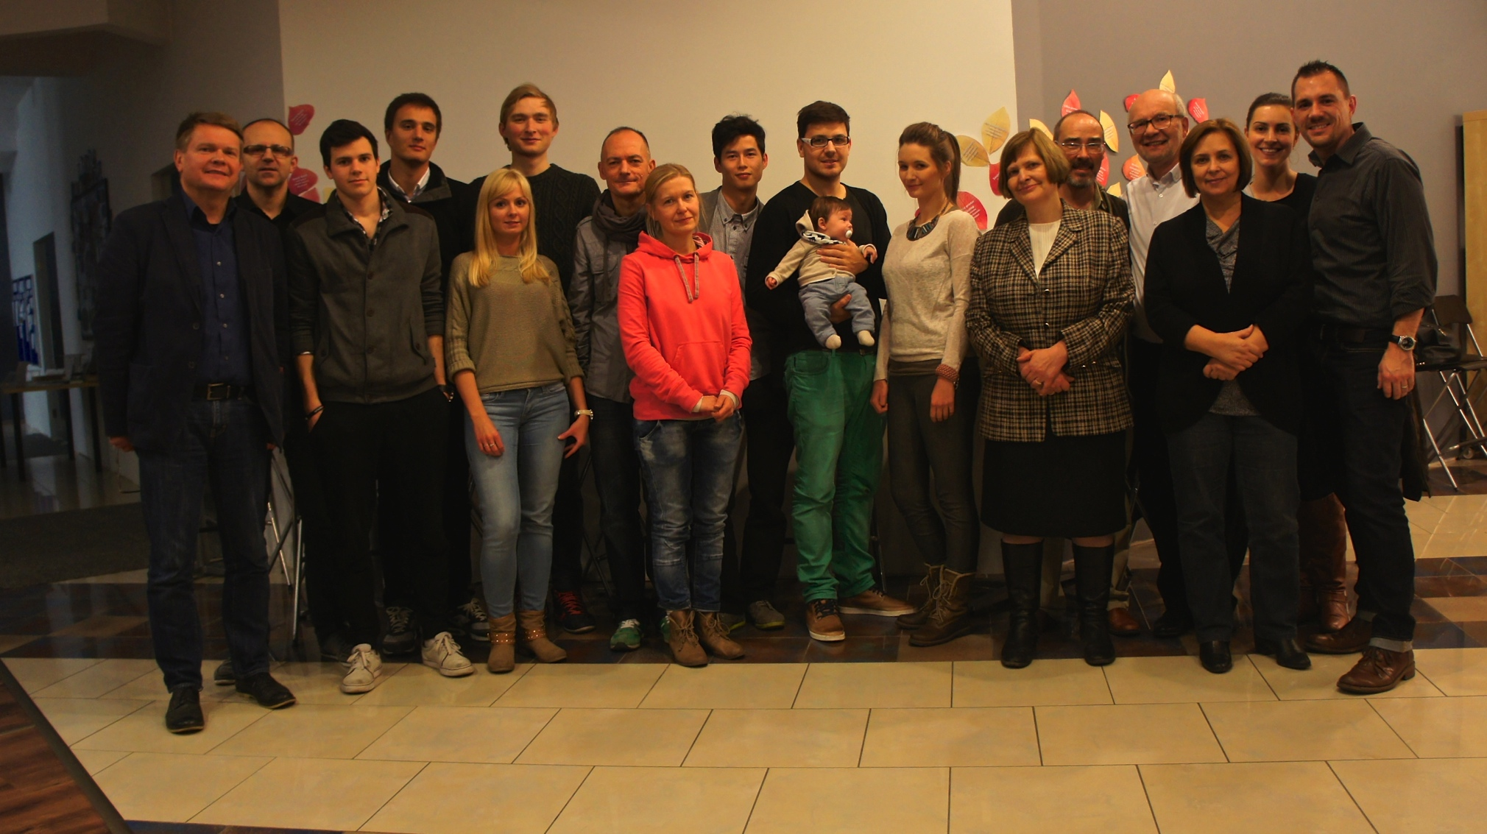
Emerging Leaders Interns (ELI) are half way through their second year of equipping and training. PCM and Taylor University students recently participated in a prayer initiative with them in the Wilanów district of Warsaw. Wilanów is the targeted area for the next Warsaw church plant. Currently, it has 30,000 residents and is growing rapidly.

Slide 12
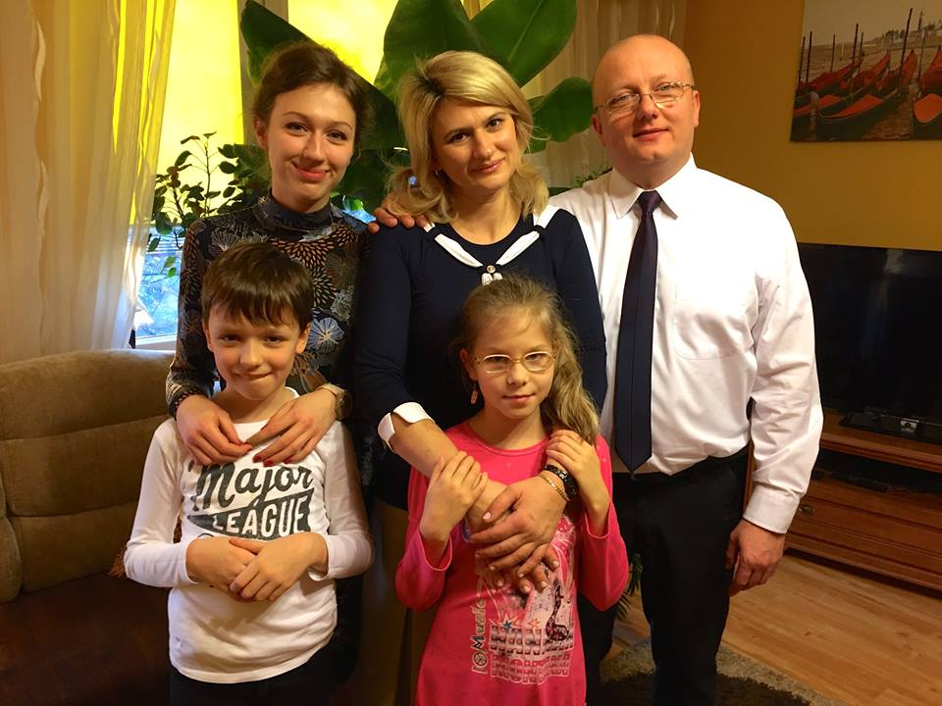
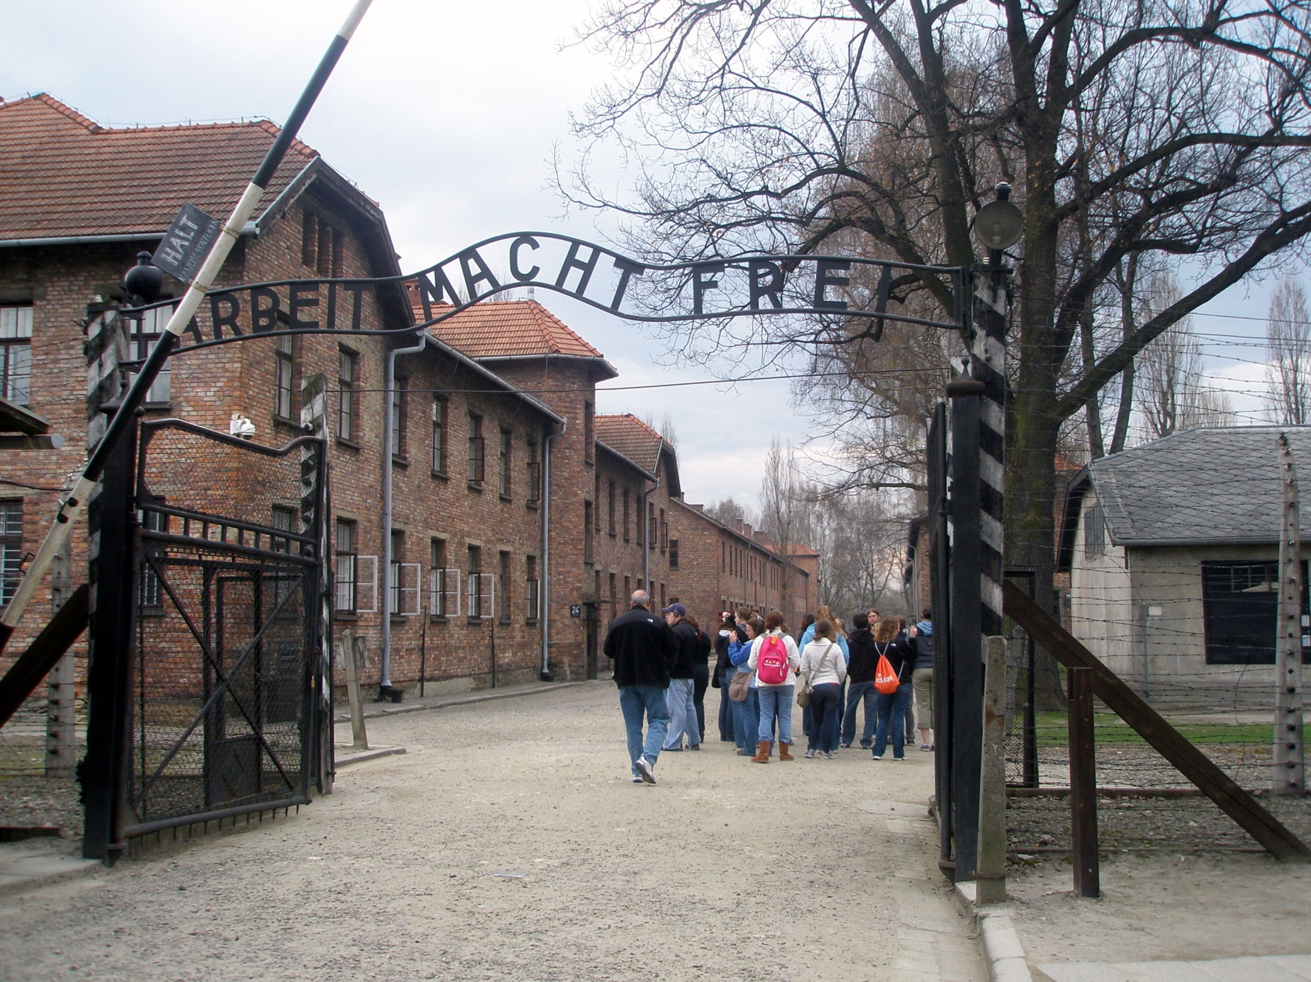
This is Krzysztof Adamkowski and his family who lead the church in Ciechanów. They are in need of a US Living Link church. PCM is looking for LL’s for 7 Polish churches.

Slide 13
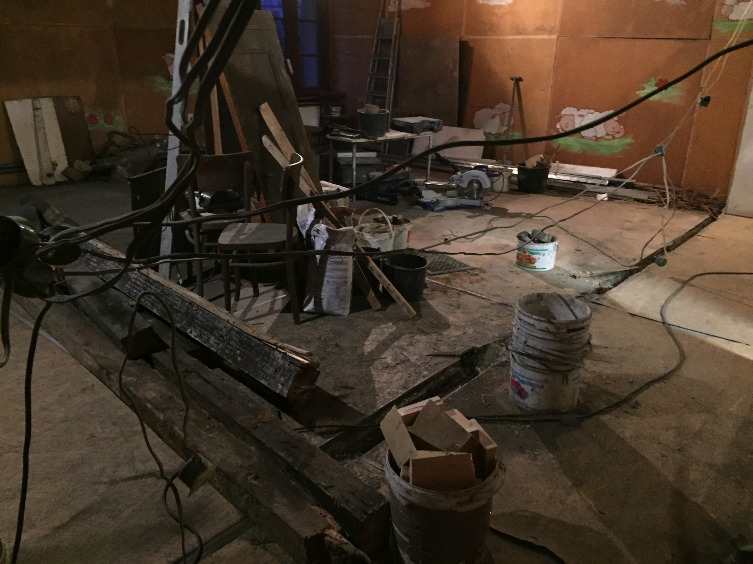
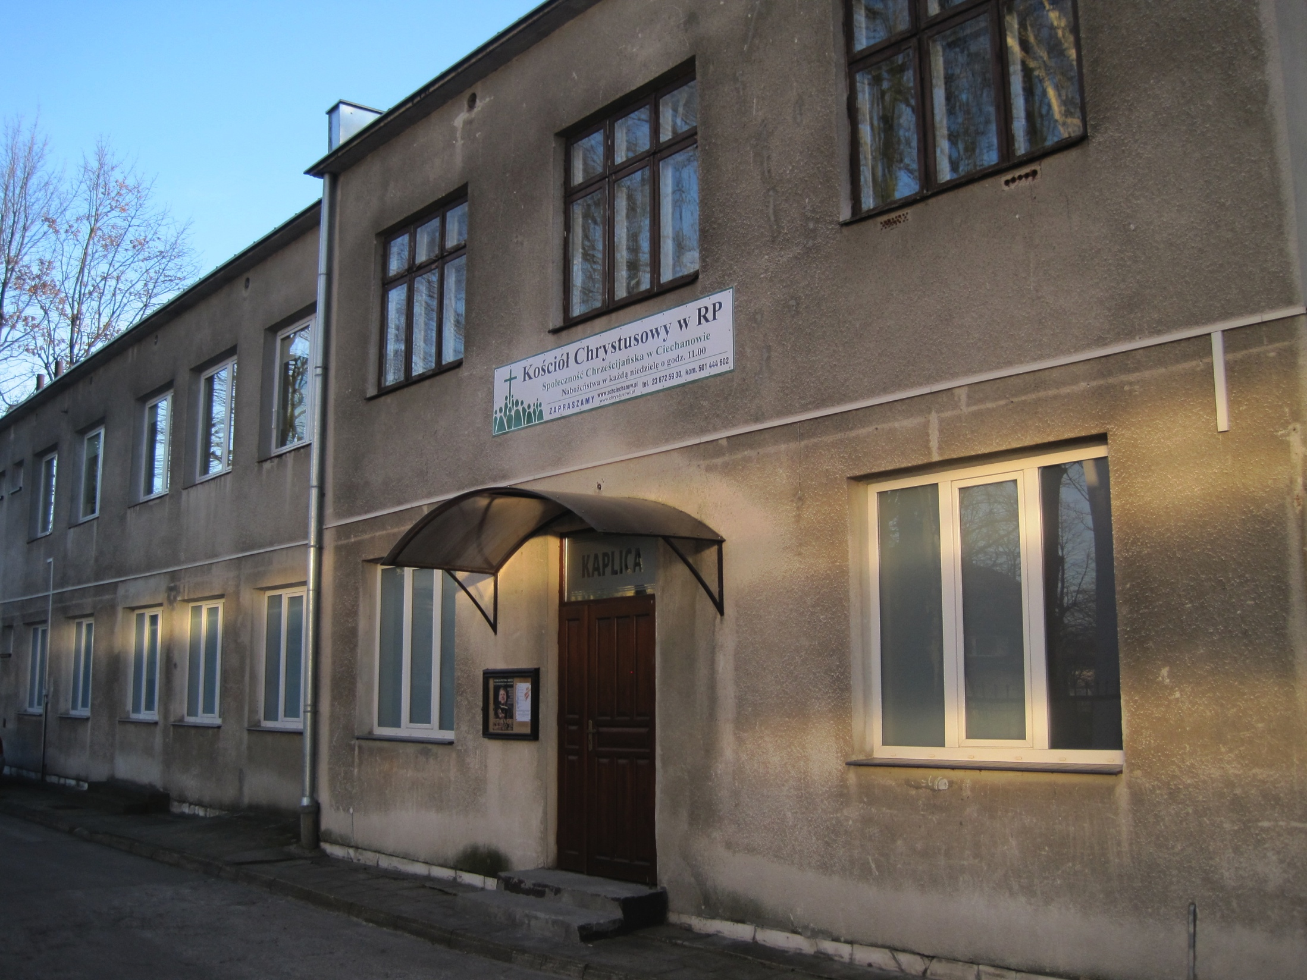
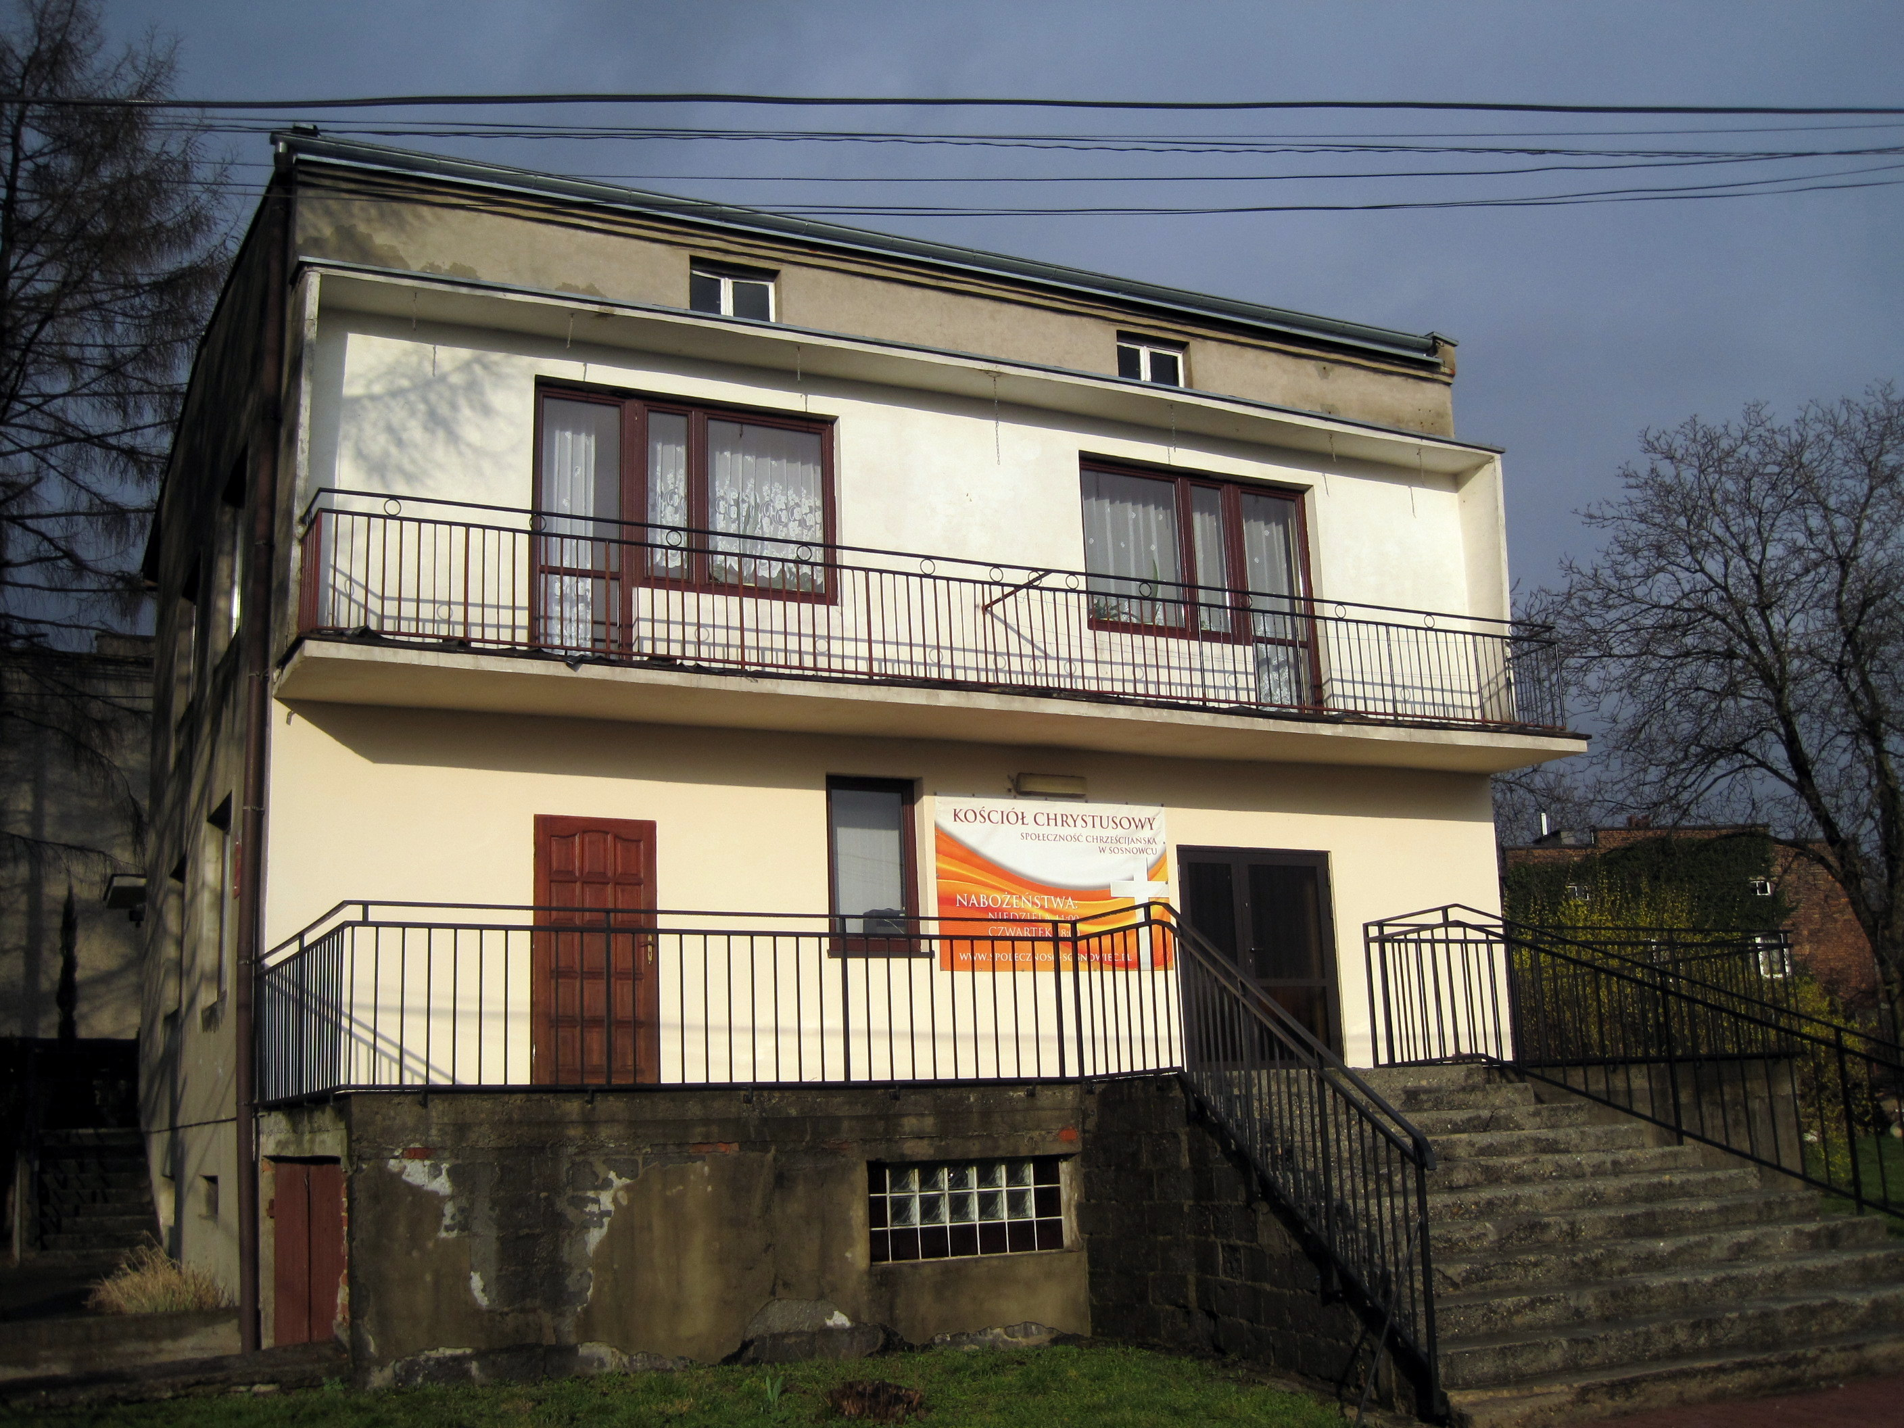
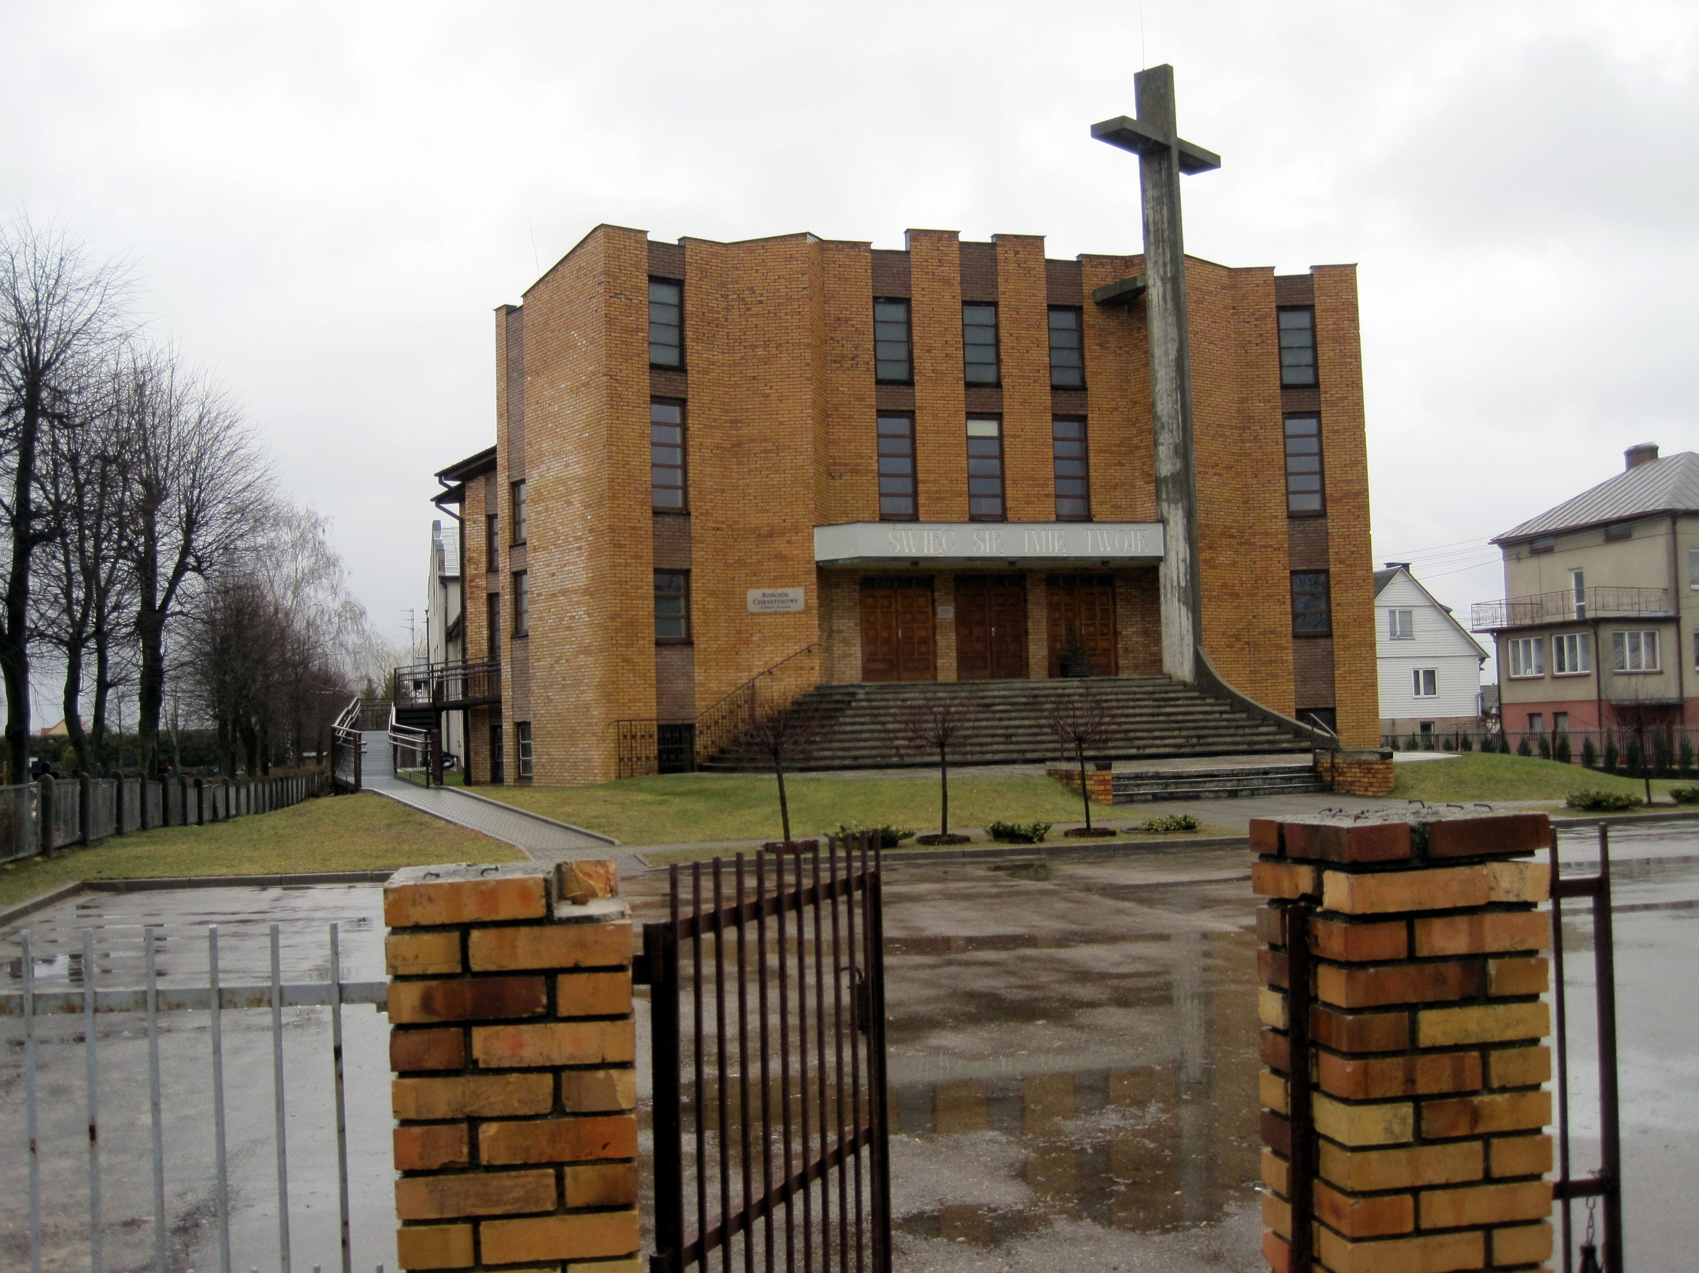
Building projects/reno
Biala Podlaska (lay foundation for new building)
Olsztyn (roof repairs)
Bielsk Podlaski (reno guest rooms)
Ciechanow (insulation)
Dabrowa Gornicza (foyer wall)
Sosnowiec
There are several church building projects. Their needs range from $5K to $100K. Projects include everything from repairng roofs & classrooms to new construction.

Slide 14
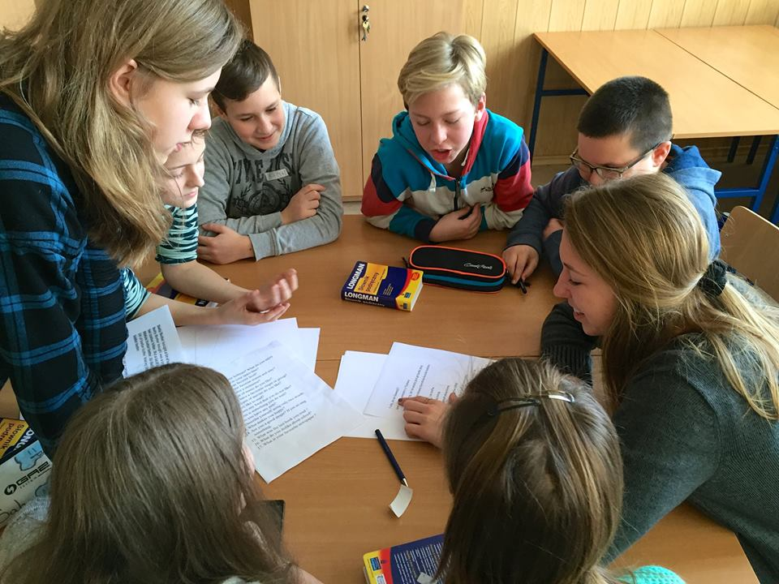
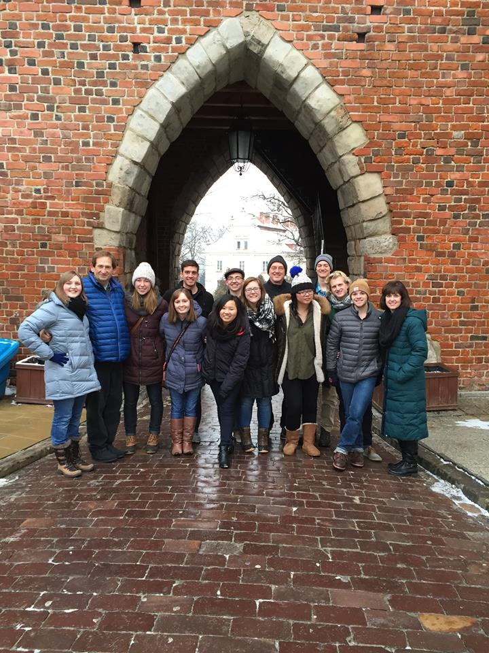
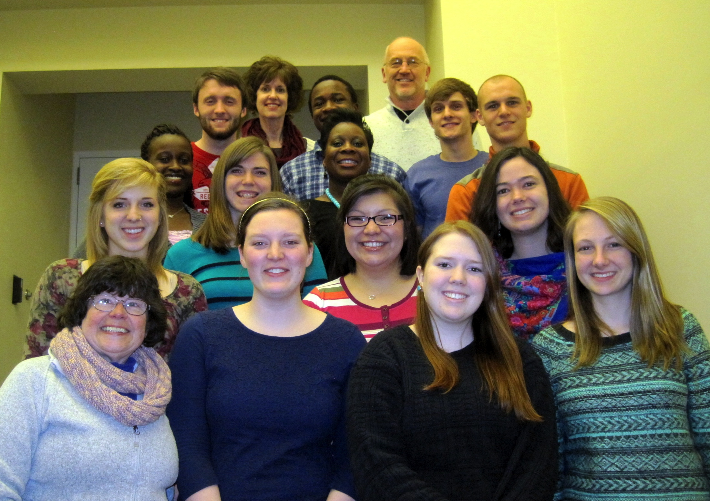
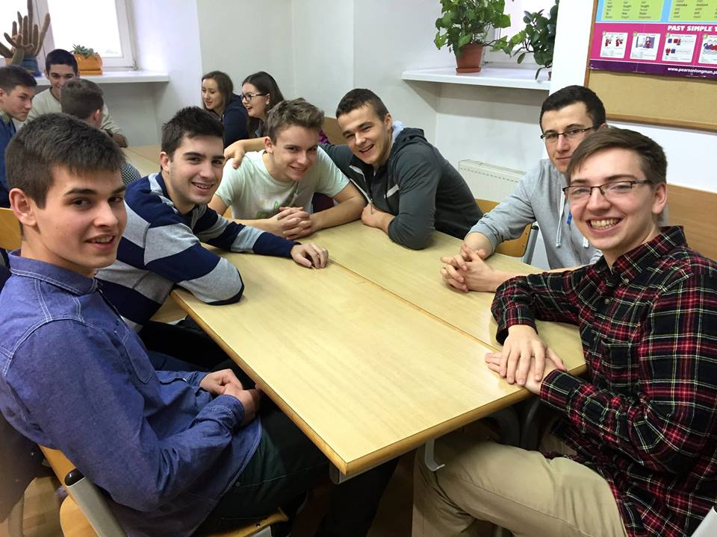

US teams come to Poland to assist Polish churches in building relationships with their city and region. Sometimes it is in the form of teaching English in local schools.

Slide 15
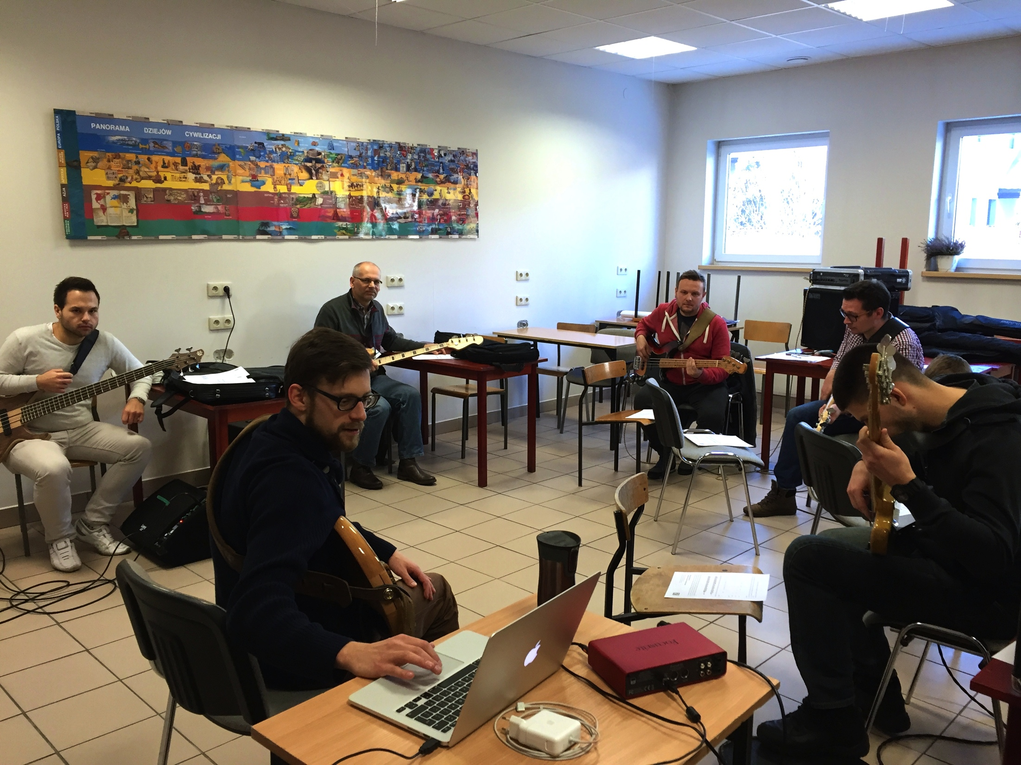
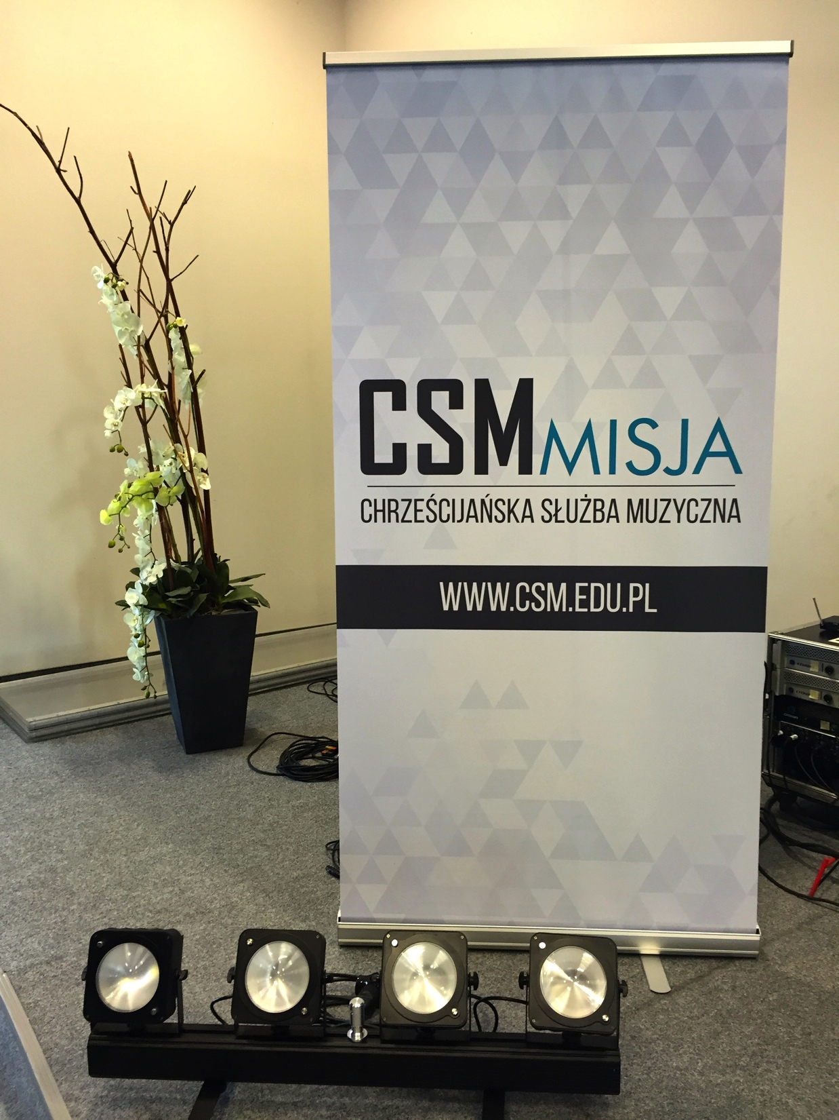

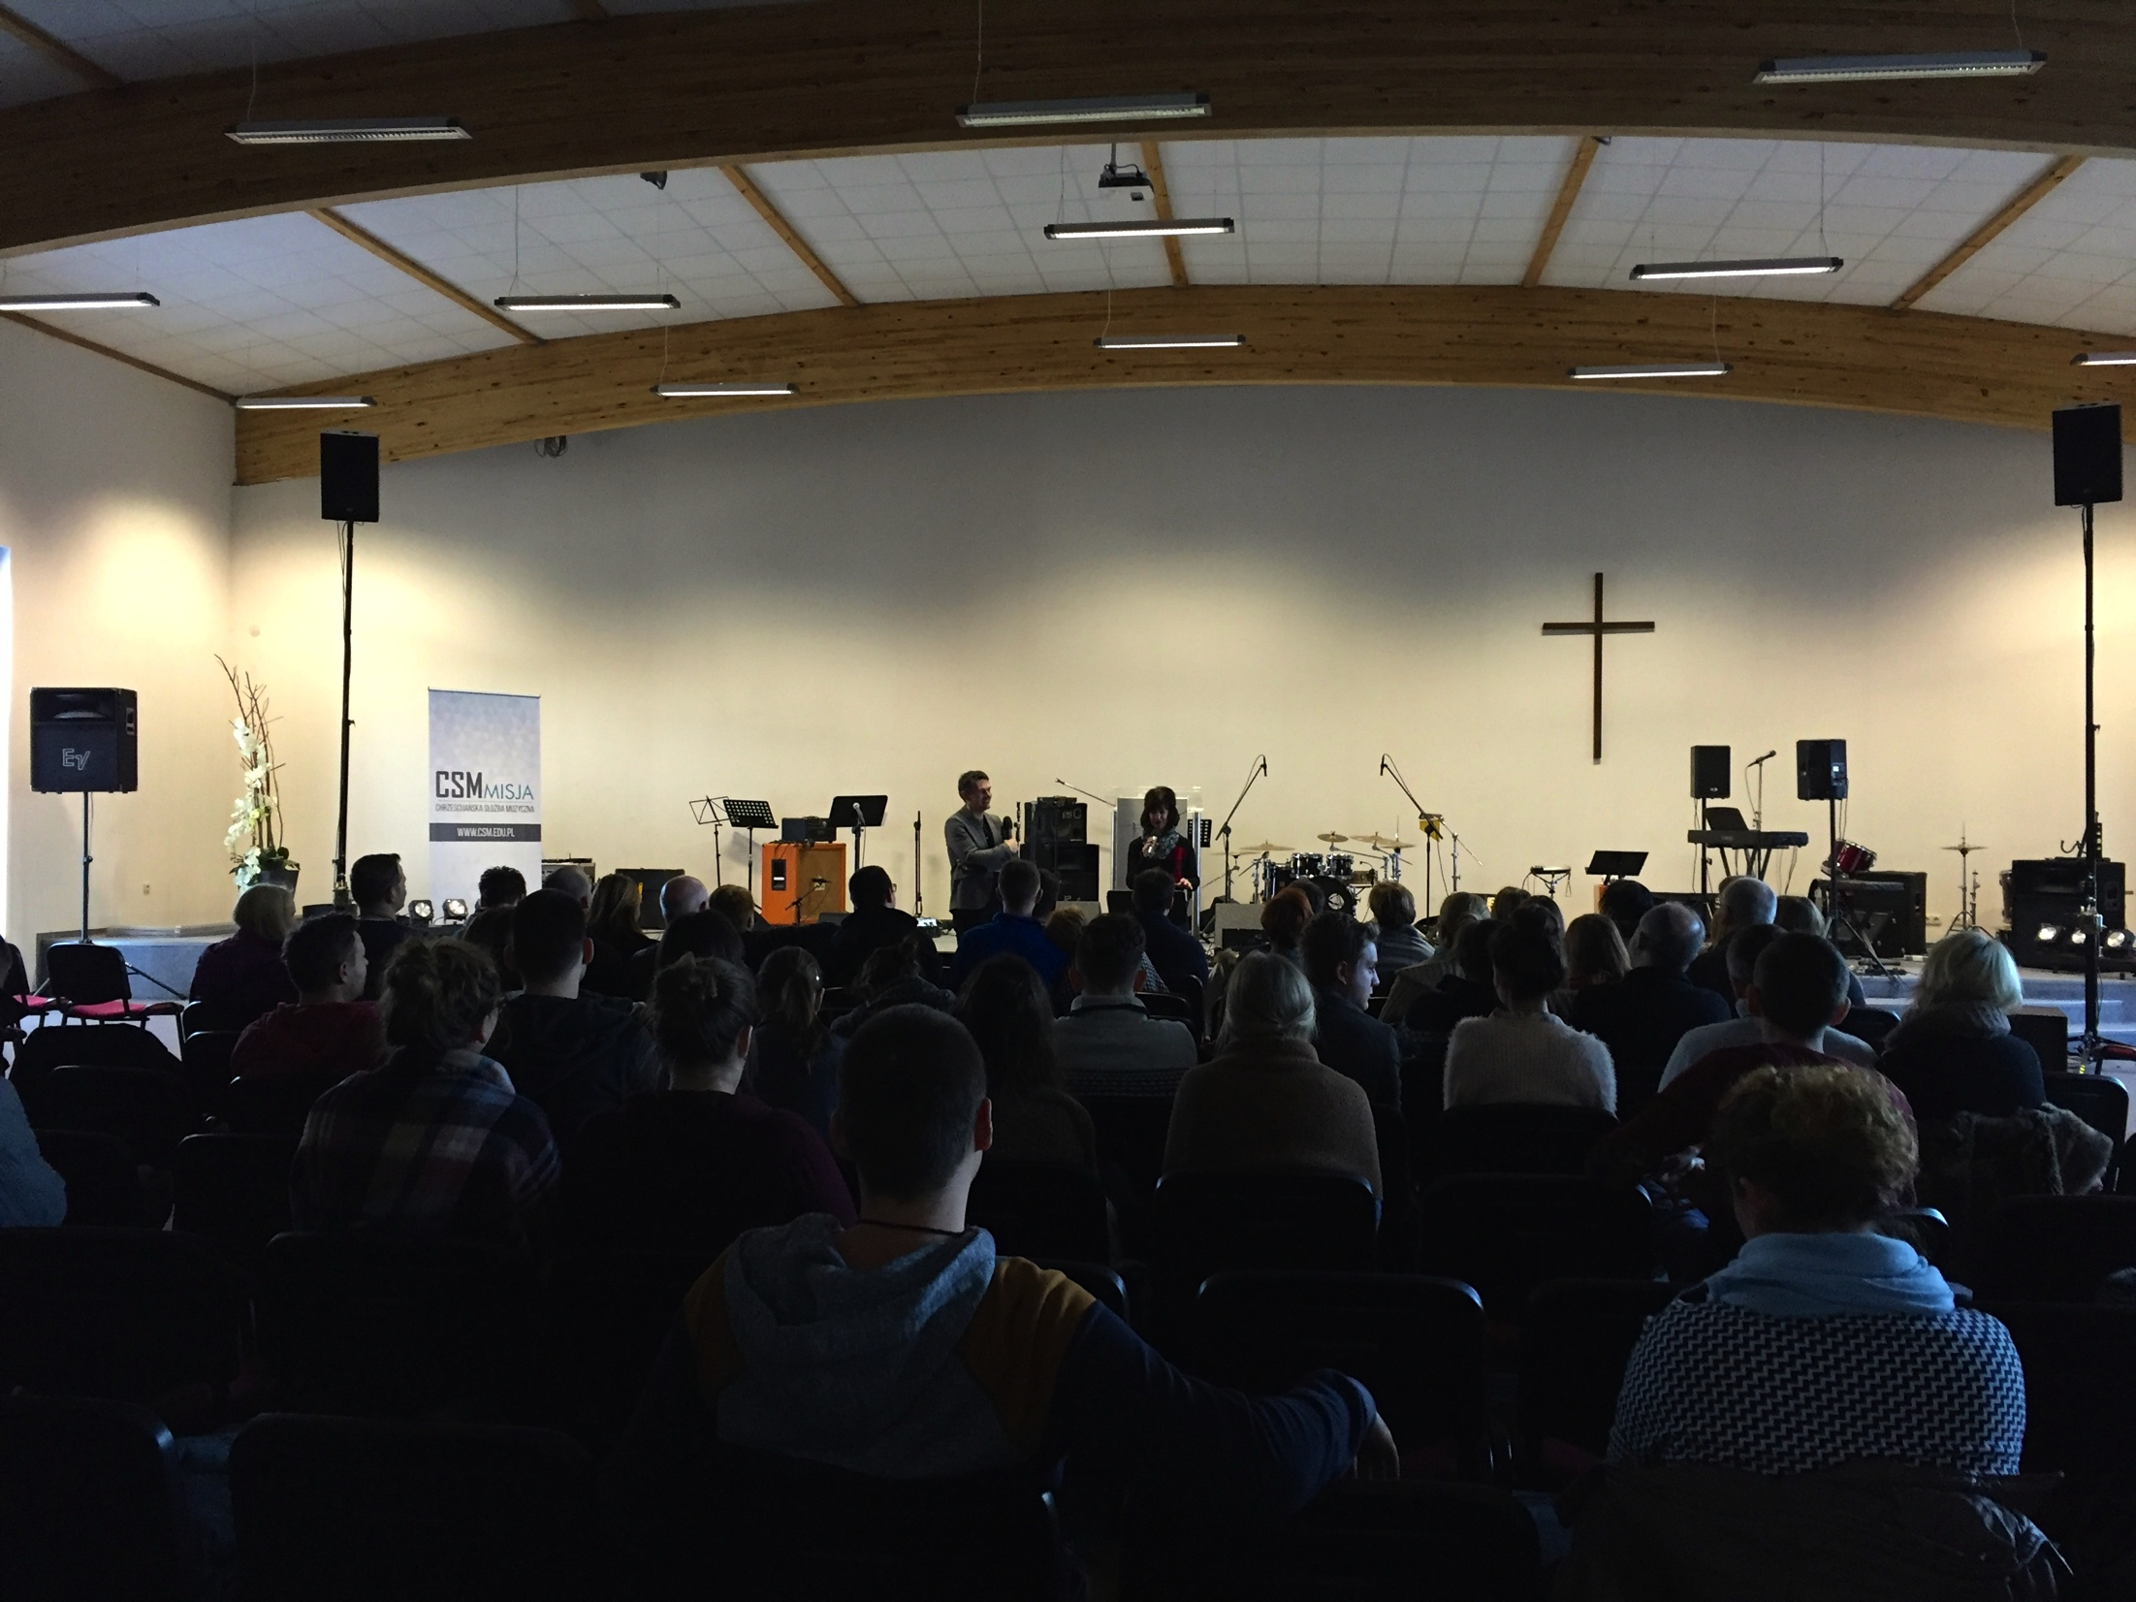
PCM partners with CSM, a Christian training school for musicians and worship leaders. CSM has 111 students during the 2015-16 school year. Its goal is to provide musical training and spiritual inspiration for those involved in worship.

Slide 16
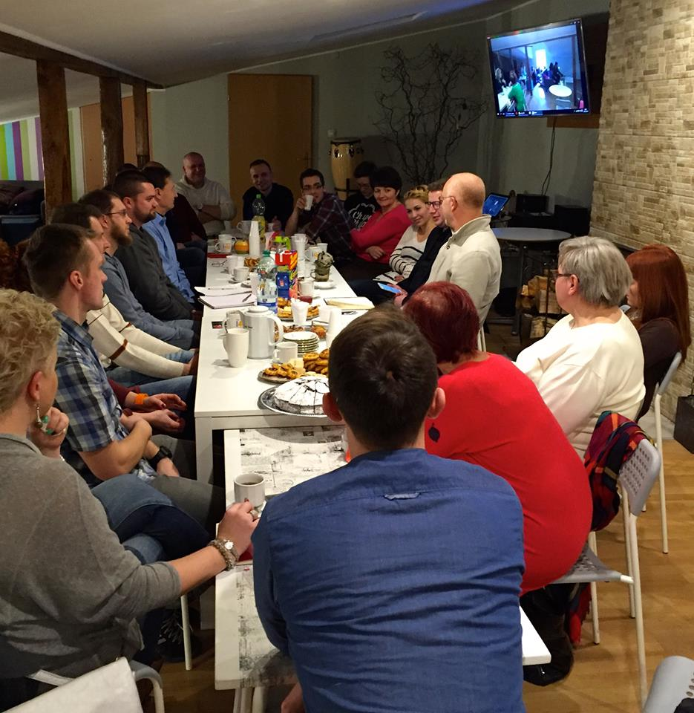
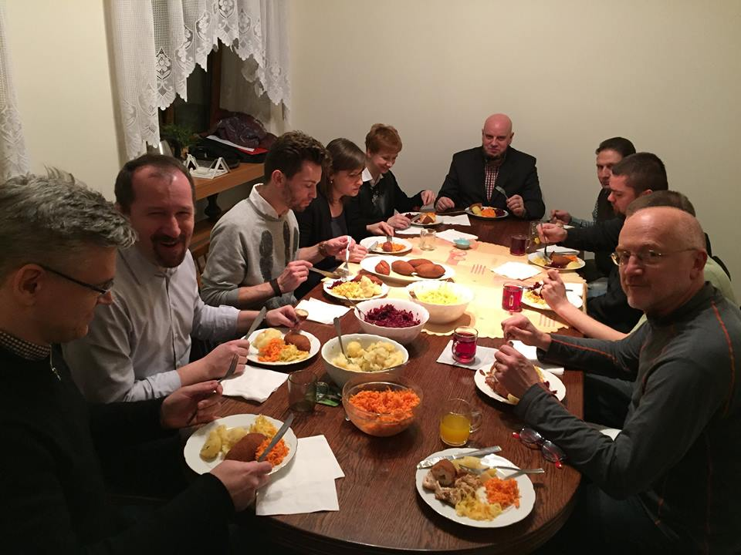
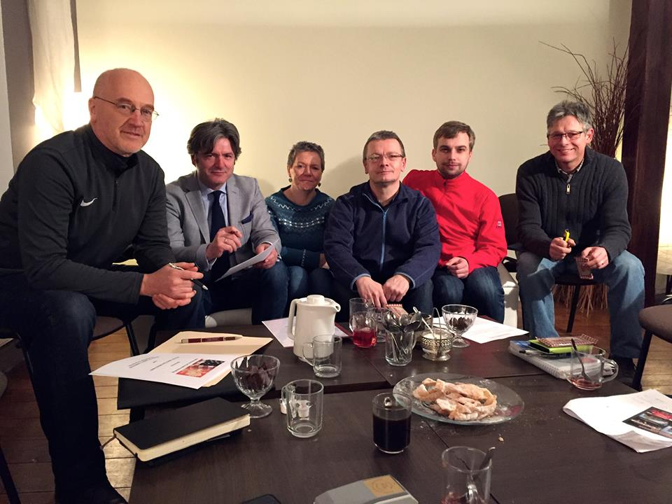
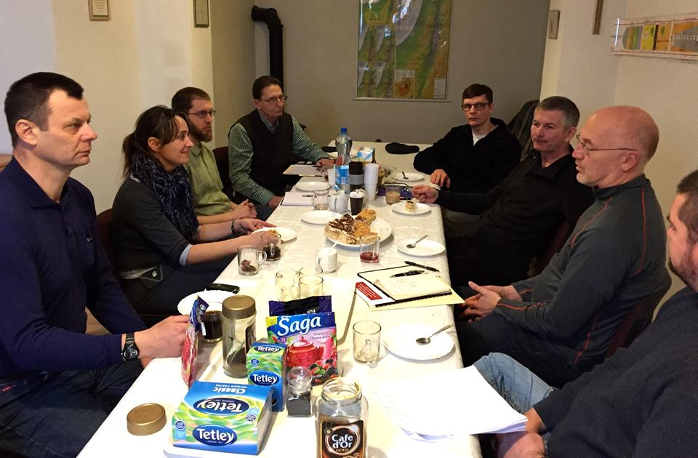
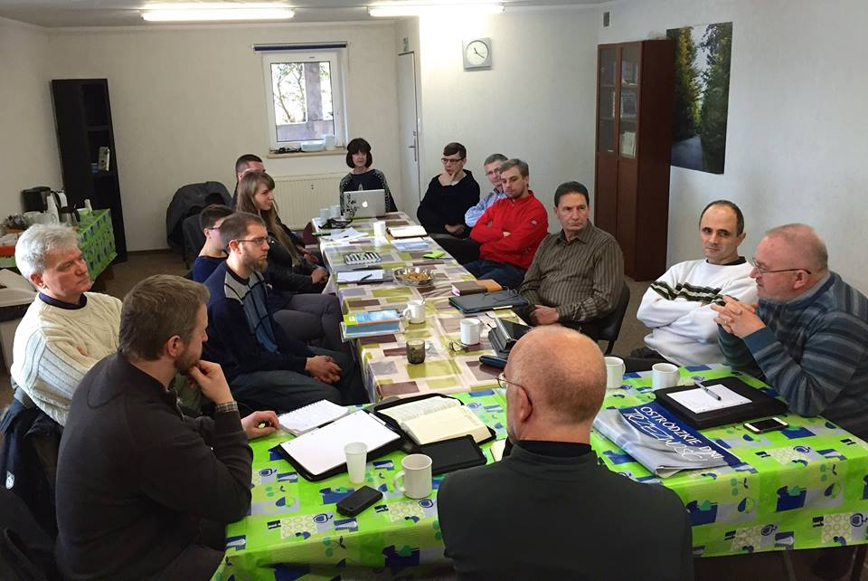
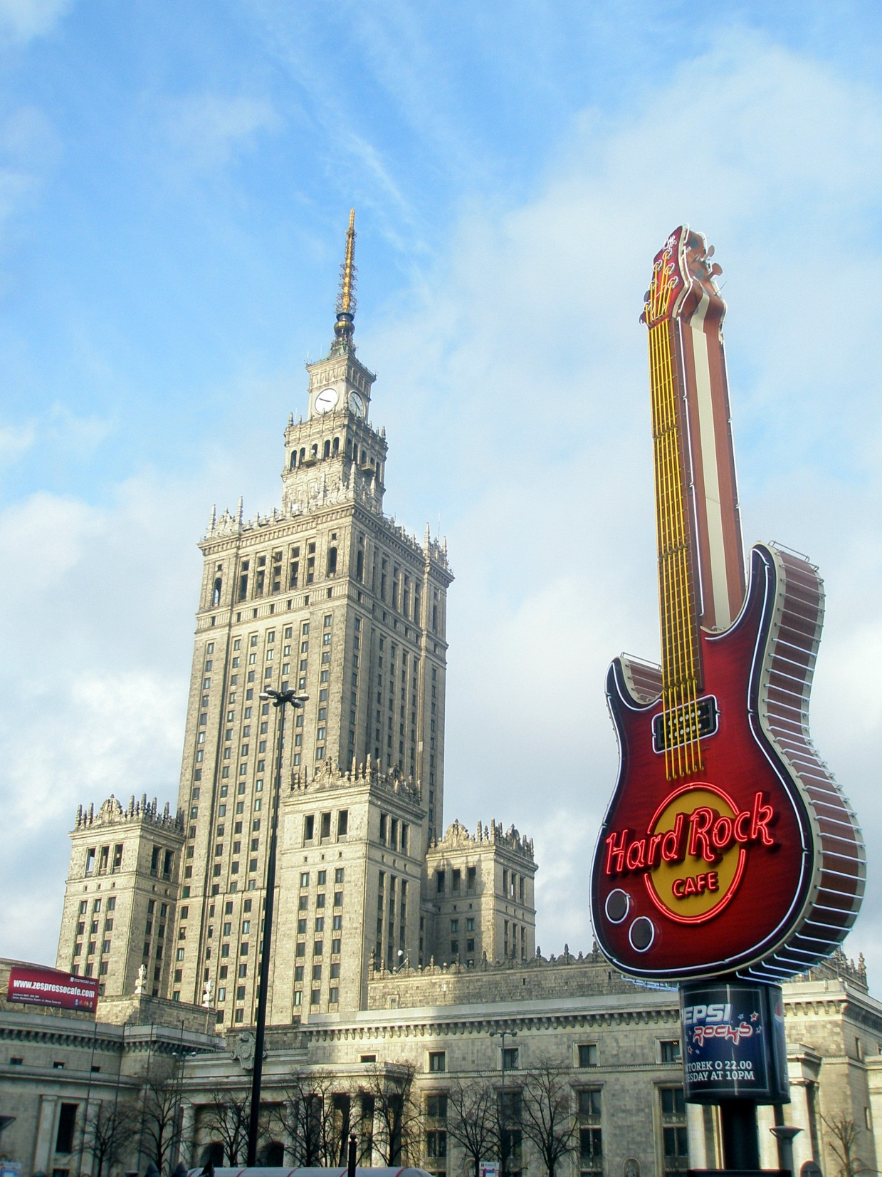
PCM meets with Polish church leaders to discuss vision, church growth principles and strategies, and to pray together.

Slide 17
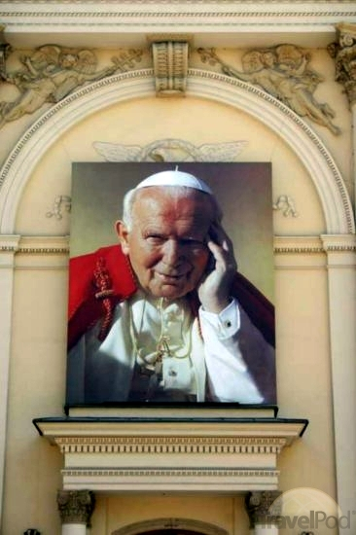
Five churches from the north central region of Poland met together to organize their first outreach camp for Polish youth. A US team will support this camp along with PCM US interns.

Slide 18
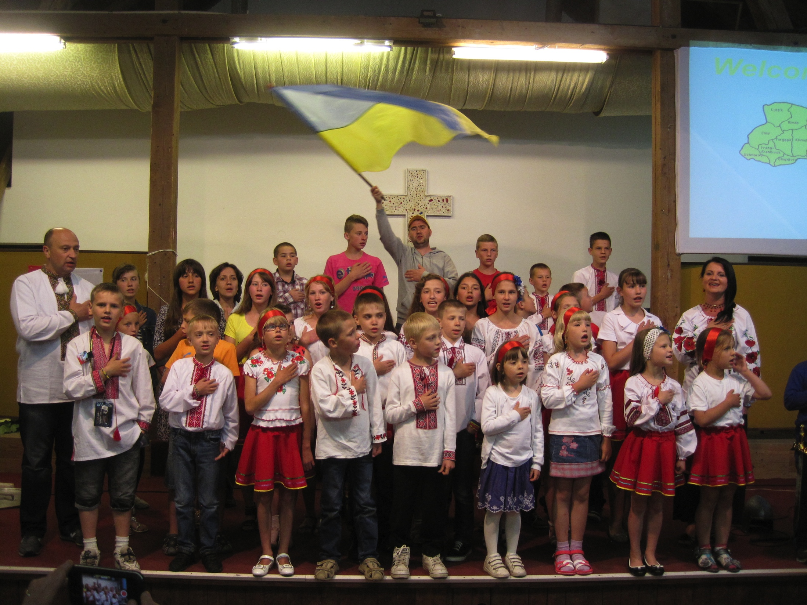
Eighty Ukrainian refugee children, counselors and translators will come to Poland in June 2016. Please pray for these children to hear the truth of God’s Word.

Slide 19

Compassion CC, Savannah, GA
CC, Mt. Vernon, IL
Hillside CC, Marshfield, MO
Fairmount CC, Richmond, VA
New Hope CC, Whitestown, IN Tomoka CC, FL
Five people have applied PCM interns this summer (Camp Ostroda but also Warsaw Wilanow)
2016 Poland Bound
Bloomsburg CC, Bloomsburg, PA 10 Cities Living Link Tour
Compassion CC, Savannah, GA “Send Me” Holocaust survivors
Central CC, Mt. Vernon, IL Biała Podlaska Laying a Foundation
Hillside CC, Marshfield, MO Ostróda Ukrainian refugees
Perimeter Church, Atlanta, GA Ostróda Polish youth camp
PCM interns, MI, TN, GA (3) Wilanów Church Plant Initiative
Fairmount CC, Mechanicsville, VA Lublin (2) Children’s Outreach
New Hope CC, Whitestown, IN Bielsk Podlaski Children’s VBS
Tomoka CC, Ormond Beach, FL Jasienica CSM e-learning edit
US teams will be building eternal relationships with Polish brothers and sisters in Christ and planting seeds of the Gospel. May many come to faith in the Lord Jesus Christ!

Slide 20
Sign up for monthly PCM eNews updates!
Follow PCM on FaceBook!
www.pcmusa.org

